Slide 1
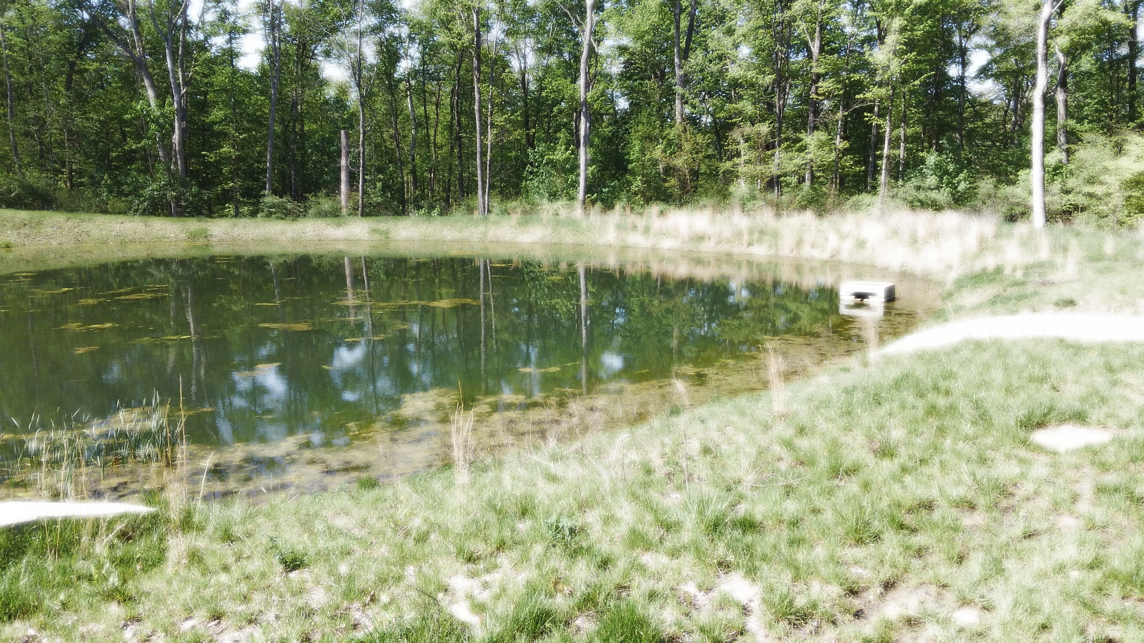
Nutrient Management
For Ponds
Pond Best Management Practices
Ways to help manage nutrient and pollution loads in ponds

Slide 2
Four main elements required for Aquatic Organisms
Carbon
Oxygen
Nitrogen
Phosphorus
Nitrogen and phosphorus are the easiest to restrict

Slide 3
What is the #1 pollutant in area waters?
Sediment

Slide 4
Reducing the nutrient load in the watershed
Restrict / limit animal access
Reduce waterfowl (geese)
Limit livestock access
Graze below pond
Provide alterative water source
Don’t spread manure above pond
Maintain Septic Systems
Reduce fertilizer use
Test your soil to see what you need
Apply slow-release fertilizers
Proper use of irrigation systems
Lawns only need 1” of water a week
Only run irrigation twice a week, not every day
Install rain sensor
Proper yard waste disposal
Compost on site
Don’t dump in storm drains or into drainage swales / creeks

Slide 5
Pond with nutrient loading from fertilizer and septic systems

Slide 6
BMPs to keep nutrients out of the pond
Vegetative/Riparian Buffers
Grass waterways / Swales
Forebays
Constructed Treatment Wetlands
Bank Stabilization

Slide 7
Vegetative Buffers
Create and maintain vegetative buffers
Dual function, slows water allowing sediment to drop out, and filters nutrients and other pollutants.
If properly installed and maintained, they have the capacity to:
Remove up to 50% of nutrients and pesticides
Remove up to 60% of certain pathogens
Remove up to 75% of sediment

Slide 8
Vegetated Waterways / Swales
Reduce erosion
Provides some filtration of nutrients and pollutants
Provide some infiltration
Reduce phosphorus entering pond by reducing sediment transport.
Ease of maintenance, mow a few times a year.

Slide 9
Forebay in Pond
Install where largest inflow of water comes into the pond.
Provides an area to allow sediment to precipitate out of suspension before entering main pond.
Allows smaller, easier access area for future maintenance (removal of accumulated sediment)
Fairly easy retrofit for an existing pond.
Reduces turbidity in main pond if designed correctly.

Slide 10
Rock forebay in pond
Easiest retrofit style forebay
Forebays should be 5+% of total pond area
Outlet area can be level spreader or submerged level dike. (6-12” below surface, planted with emergent wetland plants)
Can also be a fully planted wetland forebay

Slide 11
Constructed Treatment Wetland
Nature’s Kidneys
Slow movement of water through system provides prolonged contact for plants and microorganisms to clean the water.
Both aerobic and anaerobic conditions to facilitate different biological and chemical reactions.
Habitat for terrestrial and aquatic fauna.
Can require a significant area to properly install

Slide 12
Bank stabilization
Reduce the amount of sediment getting into the pond.
Protect against erosion.
Can be used in the pond and in creeks and streams that feed the pond.
Can utilize a wide variety of materials and techniques to provide the best long-term results. (and fit in your budget!)
Options can include, live staking, vegetating, branch packing, tree revetments, live fasines, core logs, rip rap, or gabions.

Slide 13
BMPs to help with nutrient loads already in ponds

Slide 14
Aeration
Proper aeration will benefit the entire pond
Aerobic bacteria work 20X faster than anaerobic bacteria in breaking down waste products
Natural aeration happens in two ways:
Photosynthesis by submerged phytoplankton, algae, plants
Wind blowing across the surface of the water. The rougher the surface, the more air exchange
Artificial aeration can be accomplished with :
Diffused aeration (bubbler) can also reduce stratification of deeper ponds
Fountains
Surface aerators
Aerators need to be run at night. Plants and algae respirate at night and produce CO2 not O2.

Slide 15
Dredging pond
Removes accumulated sediment and organic material.
Restore original depth of pond
Expensive
What to do with material removed from pond?

Slide 16
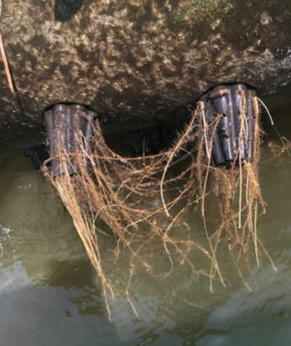
Floating Treatment Wetlands
Provide large surface area for root and microbe habitat
Can utilize multiple species of emergent plants
Not dependent on water level
Provides shade and habitat for aquatic animals

