Slide 1
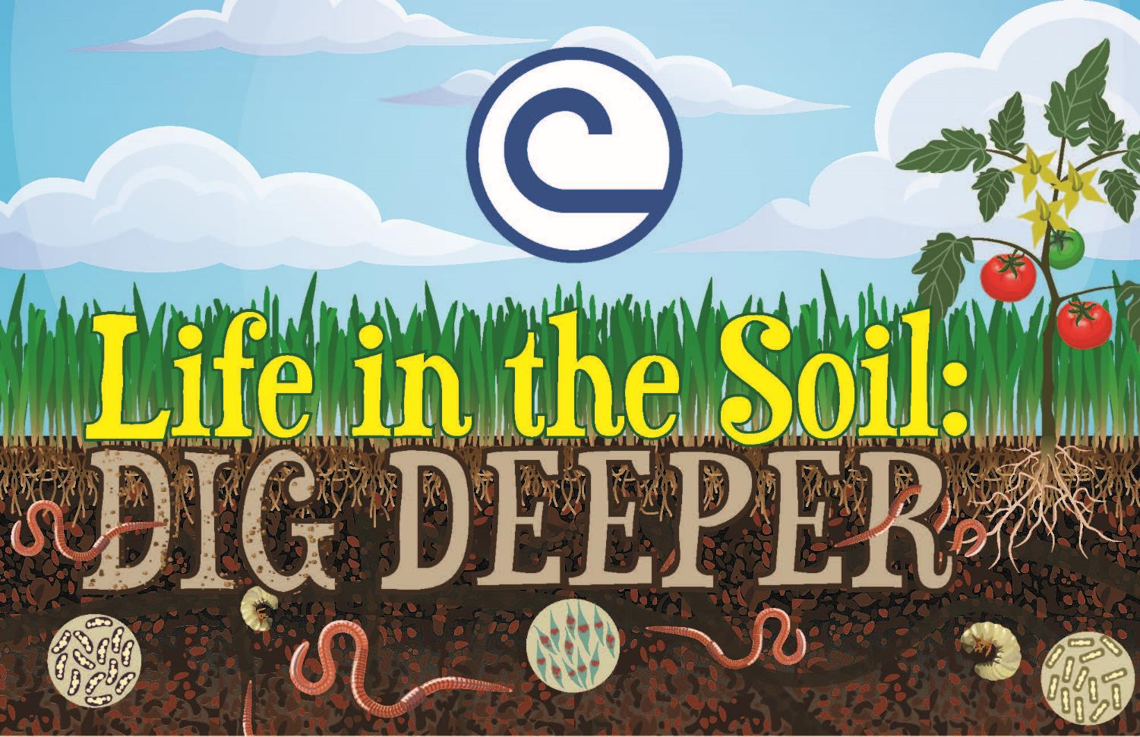
National Association of Conservation Districts (NACD)
www.nacdnet.org
Notes:
The 2019 Stewardship and Education theme is “Life in the Soil: Dig Deeper”

Slide 2
Where Does Soil Come From?
www.nacdnet.org
Notes:
Soil comes from rocks and minerals that have been broken up into tiny pieces. Soils can be many different colors because they come from many different rocks and minerals.

Slide 3
Where is the Soil?
www.nacdnet.org
Notes:
About 75% of Earth’s surface is covered with water. Most of the remaining 25% is covered with soil and not all of that is fertile and suitable for farming. A soil profile can be a useful tool to determine how fertile a soil may be.

Slide 4
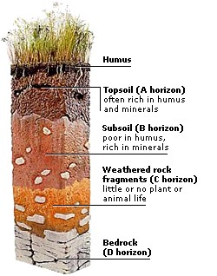
What is a Soil Profile?
www.nacdnet.org
Notes:
A soil profile is a section of soil from the top layer at the surface down to the rock or sediment layer from which the soil was originally formed. The different layers from top to bottom and in between are called horizons. Not all soil profiles look alike! There are many types of soils and their profiles can vary in colors, depth of horizons and many other ways.

Slide 5
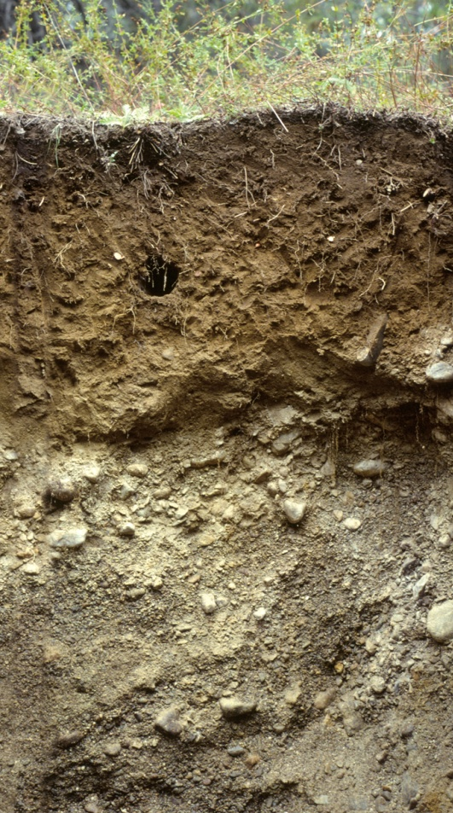
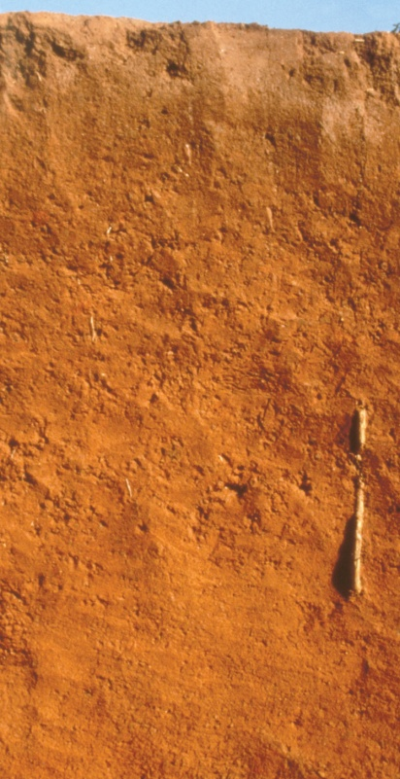
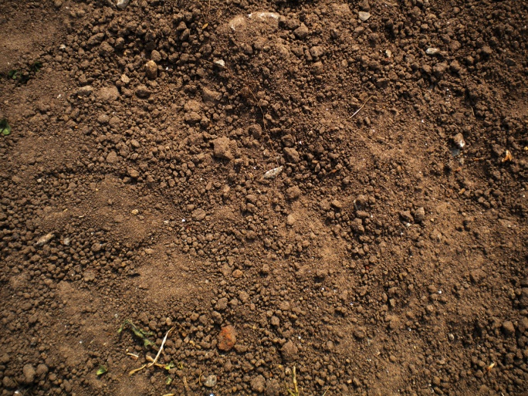
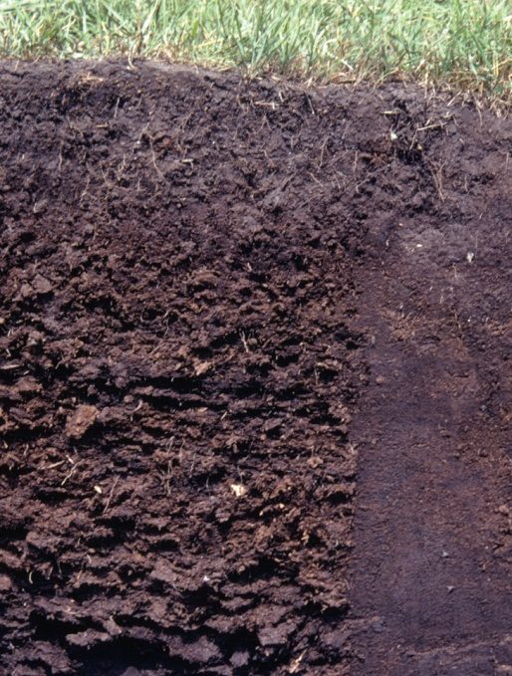
Soil and Skin – Many Colors
www.nacdnet.org
Notes:
Soil comes in many colors just like our skin does. Organic matter, minerals, and the amount of moisture in soil are a few of the things that affect its color. For example, the mineral manganese oxide causes a black color in soil and the mineral glauconite makes soil look green.

Slide 6
A Comfy Home in the Soil
www.nacdnet.org
Notes:
We aren’t the only ones who need soil. When you stand on soil, you are standing on something that is alive.
Earthworms may not have a nose, but they still have to breathe! They breathe in oxygen and breathe out carbon dioxide just like we do, but they breathe through their skin! It is important that we take care of our soil because it is home to many living things like earthworms.

Slide 7
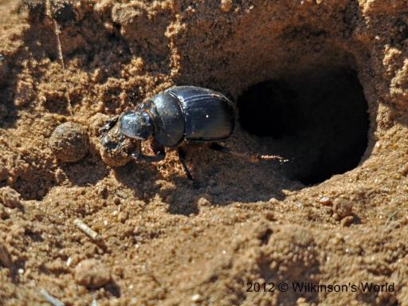
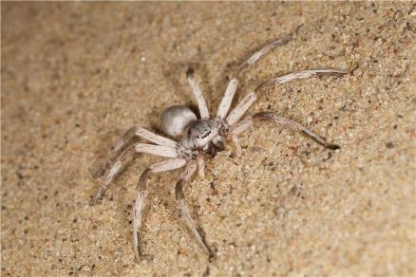
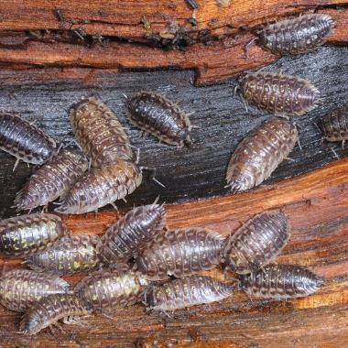
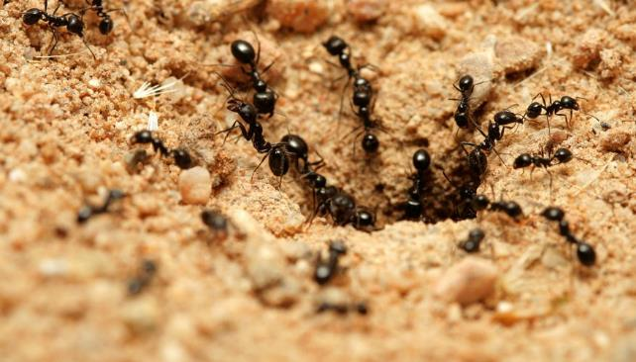
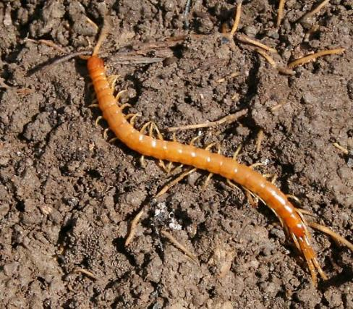
Who Else Lives in the Soil?
www.nacdnet.org
Notes:
Have you ever picked up a rock that was lying on soil and looked under it? You might have seen spiders, beetles, centipedes, millipedes, and pill bugs scurry away. Most of the living things in soil are so tiny you cannot see them. Soil is full of life that you can and cannot see. Thousands of living organisms can be found in one square inch of soil!

Slide 8
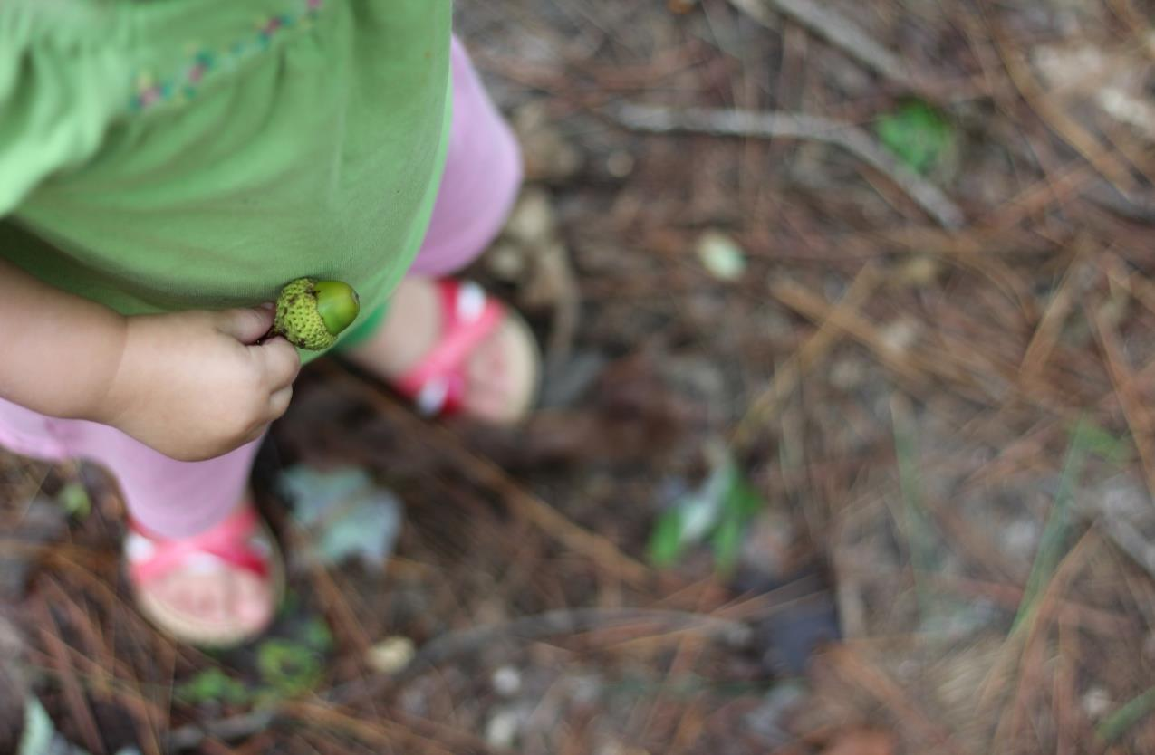
We All Need Soil
www.nacdnet.org
Notes:
It is very important to remember that we all need healthy soil. Plants and trees grow in soil. Houses are built on soil. The food we eat grows in and on soil. Soil helps clean the water we drink. Some of our clothes come from plants that grow in soil. We All Need Soil!

Slide 9
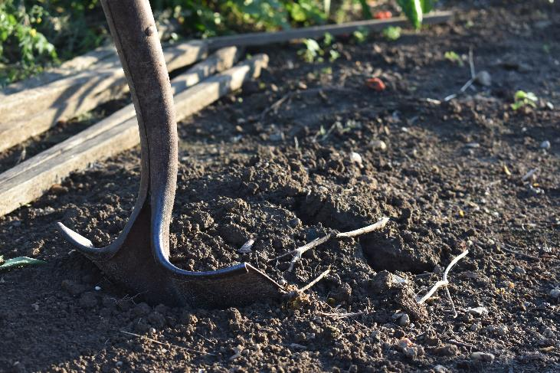
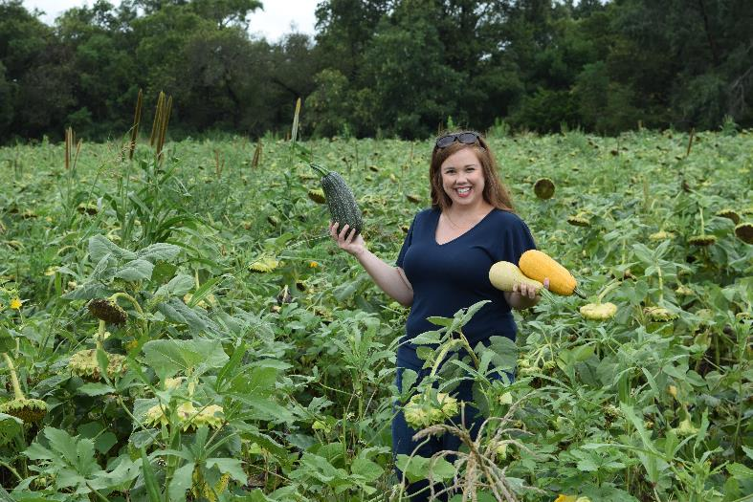
Soil Fertility and Survival
www.nacdnet.org
Notes:
Soil can take thousands or even millions of years to form! This is why it is very important to take good care of the soil we have. Soil fertility is important to all of us as the world’s population increases and the amount of available farm ground decreases. Remember…we can’t survive without healthy soil! Taking good care of our soil is the best way to make sure that we have the soil we need for food, water, air, clothes and many other things. There are many things you can do to protect your soil, like recycling and composting.

Slide 10
Recycling Protects Soil
www.nacdnet.org
Notes:
Recycling can help keep soil healthy in many ways. Recycling cuts down on our need for landfills that are built in soil. Recycling cuts down on mining in soil and saves natural resources like iron ore and coal. Recycling saves trees that grow in soil. For example, 17 trees are saved when 1 ton of paper is recycled!

Slide 11
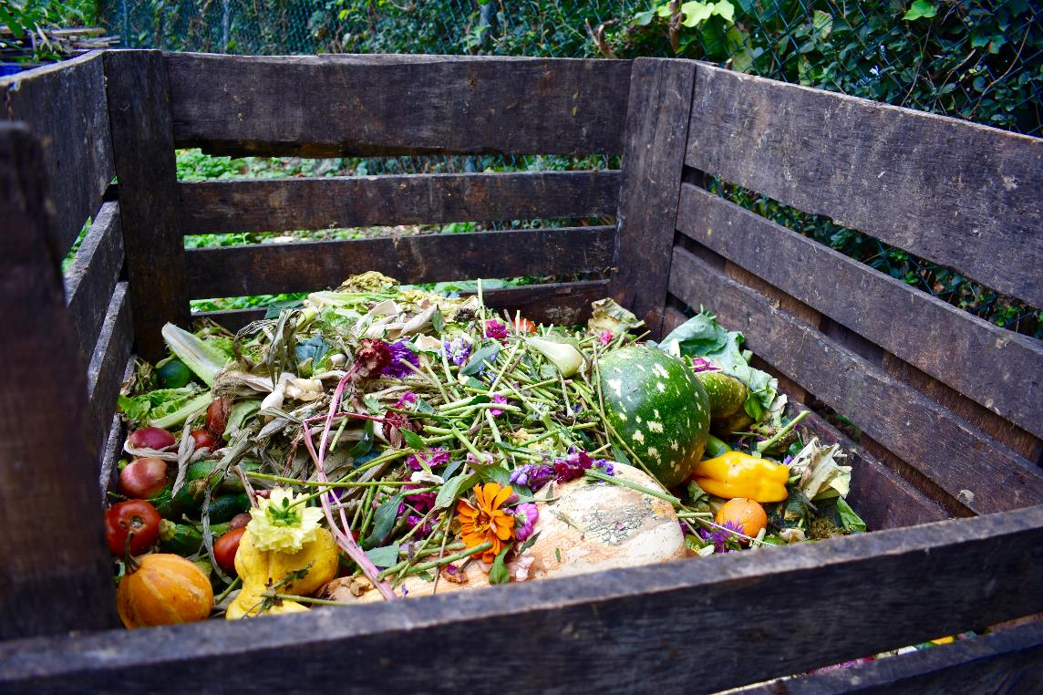
Compost for Healthy Soil
www.nacdnet.org
Notes:
Composting is a super way to reuse organic waste instead of throwing it away. You can compost dead leaves and grass, newspaper, and even vegetable scraps from dinner. You can spread compost around your plants and trees. You can work it into the soil before you plant a garden or you can spread it on top of your lawn. Adding compost is like giving the soil a vitamin!

Slide 12
Mulch is Good for Soil
www.nacdnet.org
Notes:
Mulch helps keep weeds away, helps keep plant roots from getting too hot or too cold, and helps keep soil moist. Mulch also adds nutrients to soil as it decomposes. Straw, dry leaves, wood shavings and pine needles can all be used as mulch. Spread mulch in a thick layer around your plants and watch them grow!

Slide 13
Watch Out for Erosion
www.nacdnet.org
Notes:
Take a look outside after it rains. If you see muddy water flowing it can mean that soil is mixed with the water and is being washed away. This is soil erosion. Soil is being carried away by rainwater. If you see soil erosion happening in your yard, try planting some plants or trees. Roots from plants and trees help hold soil in place, preventing erosion.

Slide 14
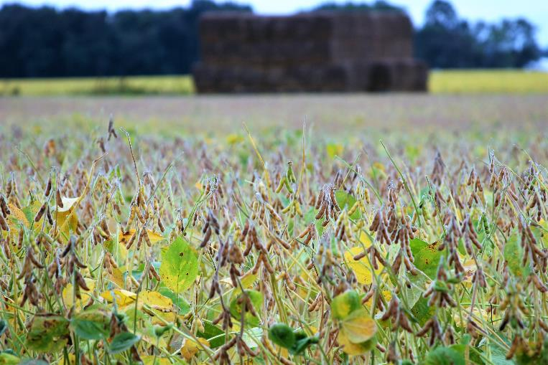
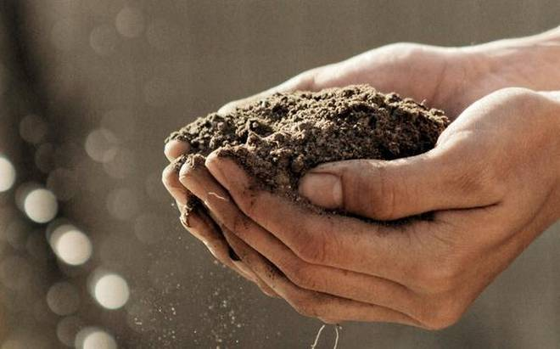
Take Care of Your Soil – It Takes Care of You
www.nacdnet.org
Notes:
Only about 10% of Earth’s land surface has suitable soil for producing our food supply, housing, cities, schools, hospitals, air to breath and more! Our healthy life above ground depends upon healthy soil below our feet! It is vital that we practice good soil conservation.

Slide 15
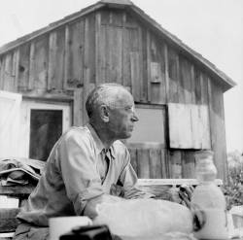
Help is Here!
“We abuse land because we regard it as a commodity belonging to us. When we see land as a community to which we belong, we may begin to use it with love and respect.” ---
Aldo Leopold, A Sand County Almanac, 1949
Your local conservation district is eager to help you care for your soil. Contact them for information.
National Association of Conservation Districts (NACD) http://www.nacdnet.org/general-resources/conservation-district-directory/
www.nacdnet.org
Notes:
Your local conservation district is eager to help you care for your soil. Contact them for information.
National Association of Conservation Districts (NACD) http://www.nacdnet.org/general-resources/conservation-district-directory/
Download the PowerPoint to your computer and add your contact information and some additional slides of projects in your community.

Slide 16
2019 POSTER CONTEST
“Life in the Soil: Dig Deeper”
The Poster Contest is open to all public, private and homeschooled students in grades K—12.
Contest Categories
K-1st Grade 2nd-3rd Grade 4th-6th Grade 7th-9th Grade 10th-12th Grade
Send entries to your local conservation district:
Hamilton County Soil and Water Conservation District
Contact your conservation district to find out the dates of your local contest!!!!
www.nacdnet.org

Slide 17
Poster Contest Details
Winning entries will be selected by your local district and sent to the state level for judging.
State winner entries will then be sent to the national level, where one overall winner will be selected and announced at the 2020 NACD Annual Meeting in Las Vegas, NV on January 26th. Winners will be posted to the NACD website.
Monetary prizes will be awarded to the 1st - 3rd place winners in each category at the national level.
$200 for 1st Place Winners
$150 for 2nd Place Winners
$100 for 3rd Place Winners
Monetary awards from the NACD Auxiliary & Albert I. Pierce Foundation
www.nacdnet.org

Slide 18
Poster Contest Rules
Turn poster in on time for judging. Your local conservation district’s entry deadline is: March 22nd, 2019
Attach poster entry form on the back of each poster and be sure it is signed by a parent or guardian.
Only digital posters (photographs or scanned copies of the hand drawn posters in a JPEG format) will be accepted at the national level. Photographs must be clear and well-framed. It is the local district/state association/auxiliary/agency’s decision what size and what kind of poster (hand drawn or digital) they accept for your local or state contest.
Entry must be contestant's original creation and may not be traced from photographs or other artists' published works.
Any media may be used to create a flat poster (ex. paint, crayons, stickers, etc.)
www.nacdnet.org

Slide 19
What makes a good Poster?
Attracts attention
Is simple and concise
Uses colors and white space effectively
Text is large enough to be easily read
www.nacdnet.org

Slide 20
Steps to follow when making a poster
Research the topic of the theme
Brainstorm ideas and make a list
Use the theme as your title:
“Life in the Soil: Dig Deeper”
Use some of the important water issues from this presentation.
Look around your community for ideas.
Talk to professionals in the industry.
Research soil health online and use the information found in your poster.
www.nacdnet.org

Slide 21
Dos and Don’ts
Don’t use staples, tacks, or tape.
Don’t use fluorescent-colored posters.
Don’t create a poster that is all words or all illustrations.
Don’t have your parent or others draw your poster for you to color in.
Don’t try to include too many ideas. A single message – clearly illustrated – is most effective.
Do limit text, and balance a combination of illustrations and words.
Do be as neat as you can and be sure to erase any penciled sketches or guidelines.
Do blend colors when using crayons or colored pencils.
Do research the theme topic as a way to brainstorm poster ideas.
www.nacdnet.org

Slide 22
What your poster will be judged on
Conservation message—50%
Visual effectiveness—30%
Originality—10% and
Universal appeal—10%
www.nacdnet.org

Slide 23
For Additional NACD Information
Visit http://www.nacdnet.org/general-resources/stewardship-program/
Entry Forms, Rules, and Resource PDF files are also available for download on the contest page.
http://www.nacdnet.org/education/contests
www.nacdnet.org

Slide 24
Essay Contest
Contest open to grades: 3rd – 12th
Essay length: 300 – 500 Words
Due Date: March 22, 2019
Essays entries are to be sent to:
Sara Fehring
Hamilton County Soil and Water Conservation District
Sara.fehring@hamilton-co.org
www.nacdnet.org

