Slide 1
Management Considerations for Residential Ponds

Slide 2
Common Pond Management Issues and Things to Consider
Surrounding Land Use
Stormwater Runoff
Excess Algae Growth
Sediment
Water Clarity
Excess Nutrients
Animal Waste
Aeration

Slide 3
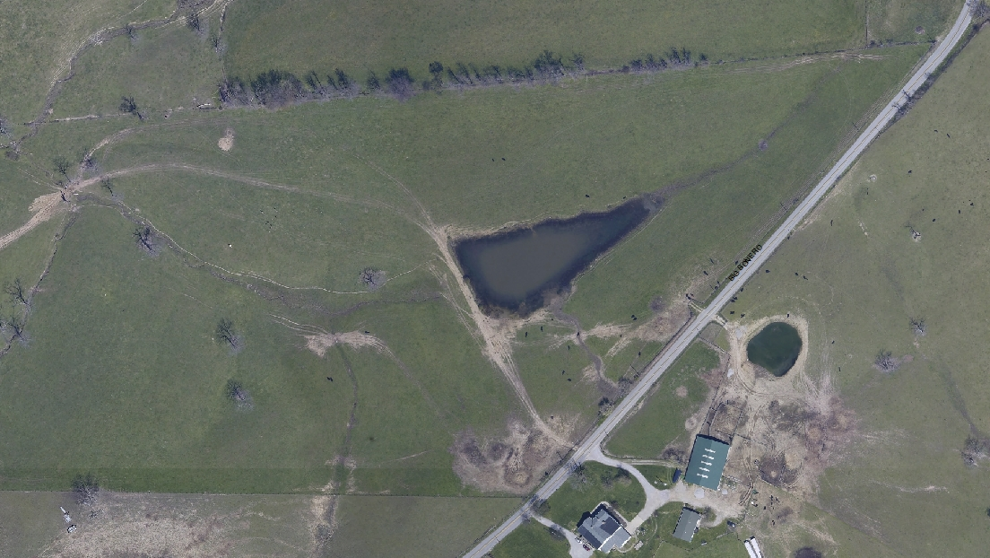
Land Use

Slide 5
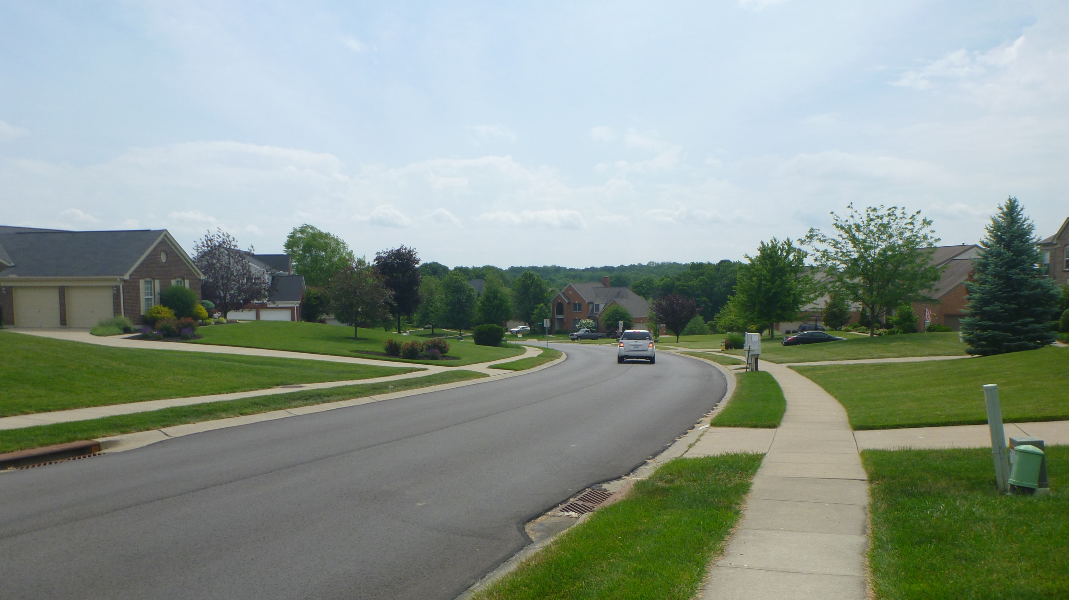
Stormwater Runoff

Slide 6
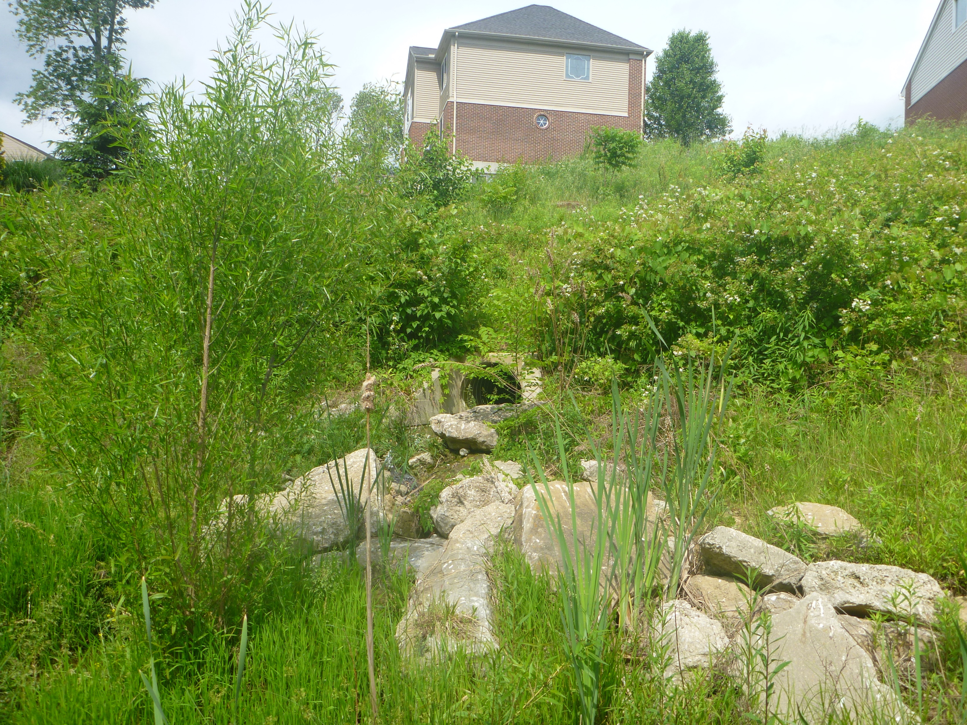

Slide 7
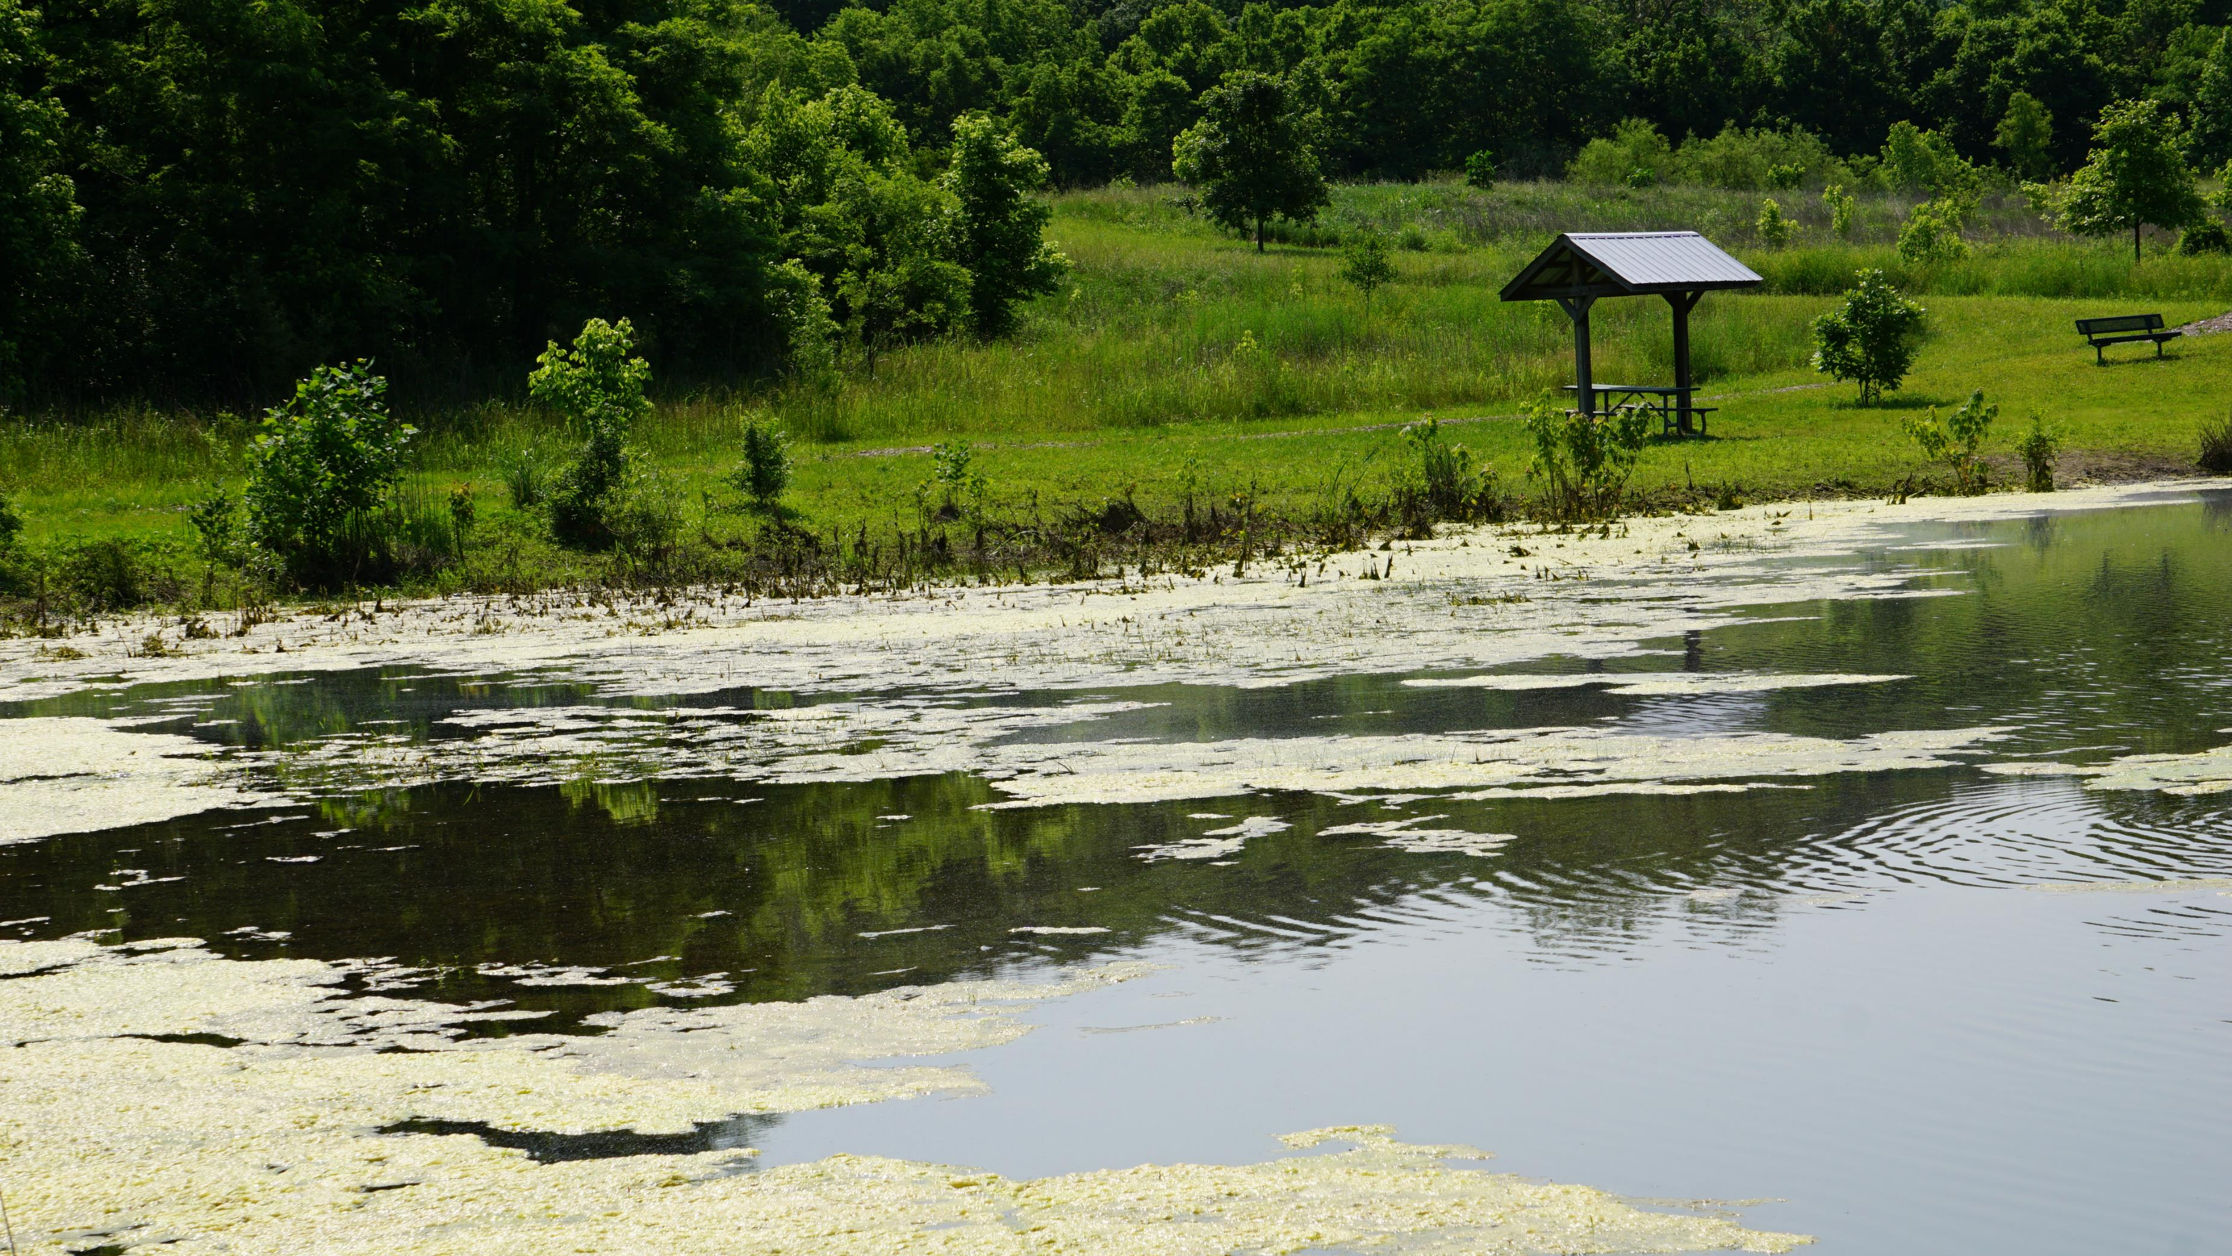
Algae

Slide 8
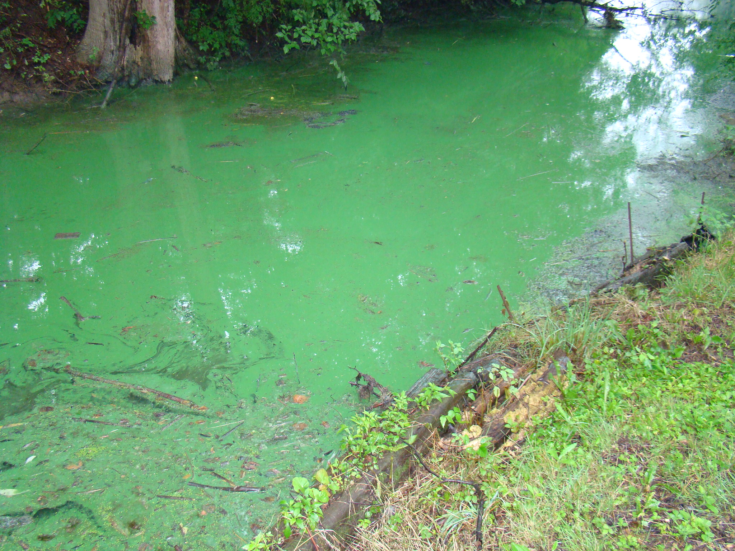

Slide 9
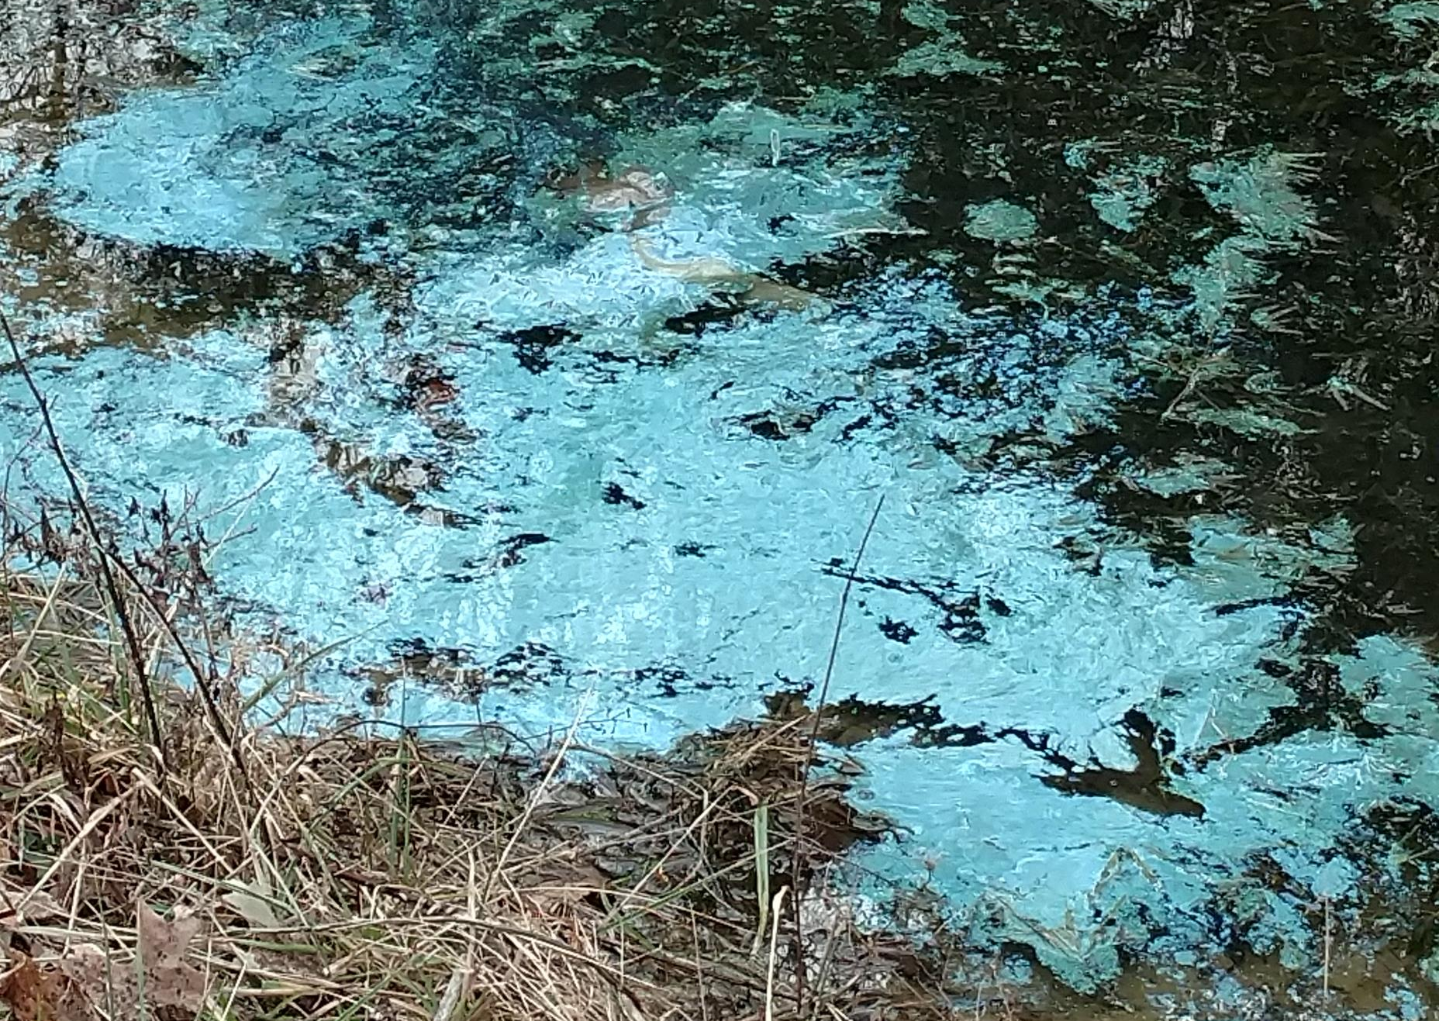

Slide 10
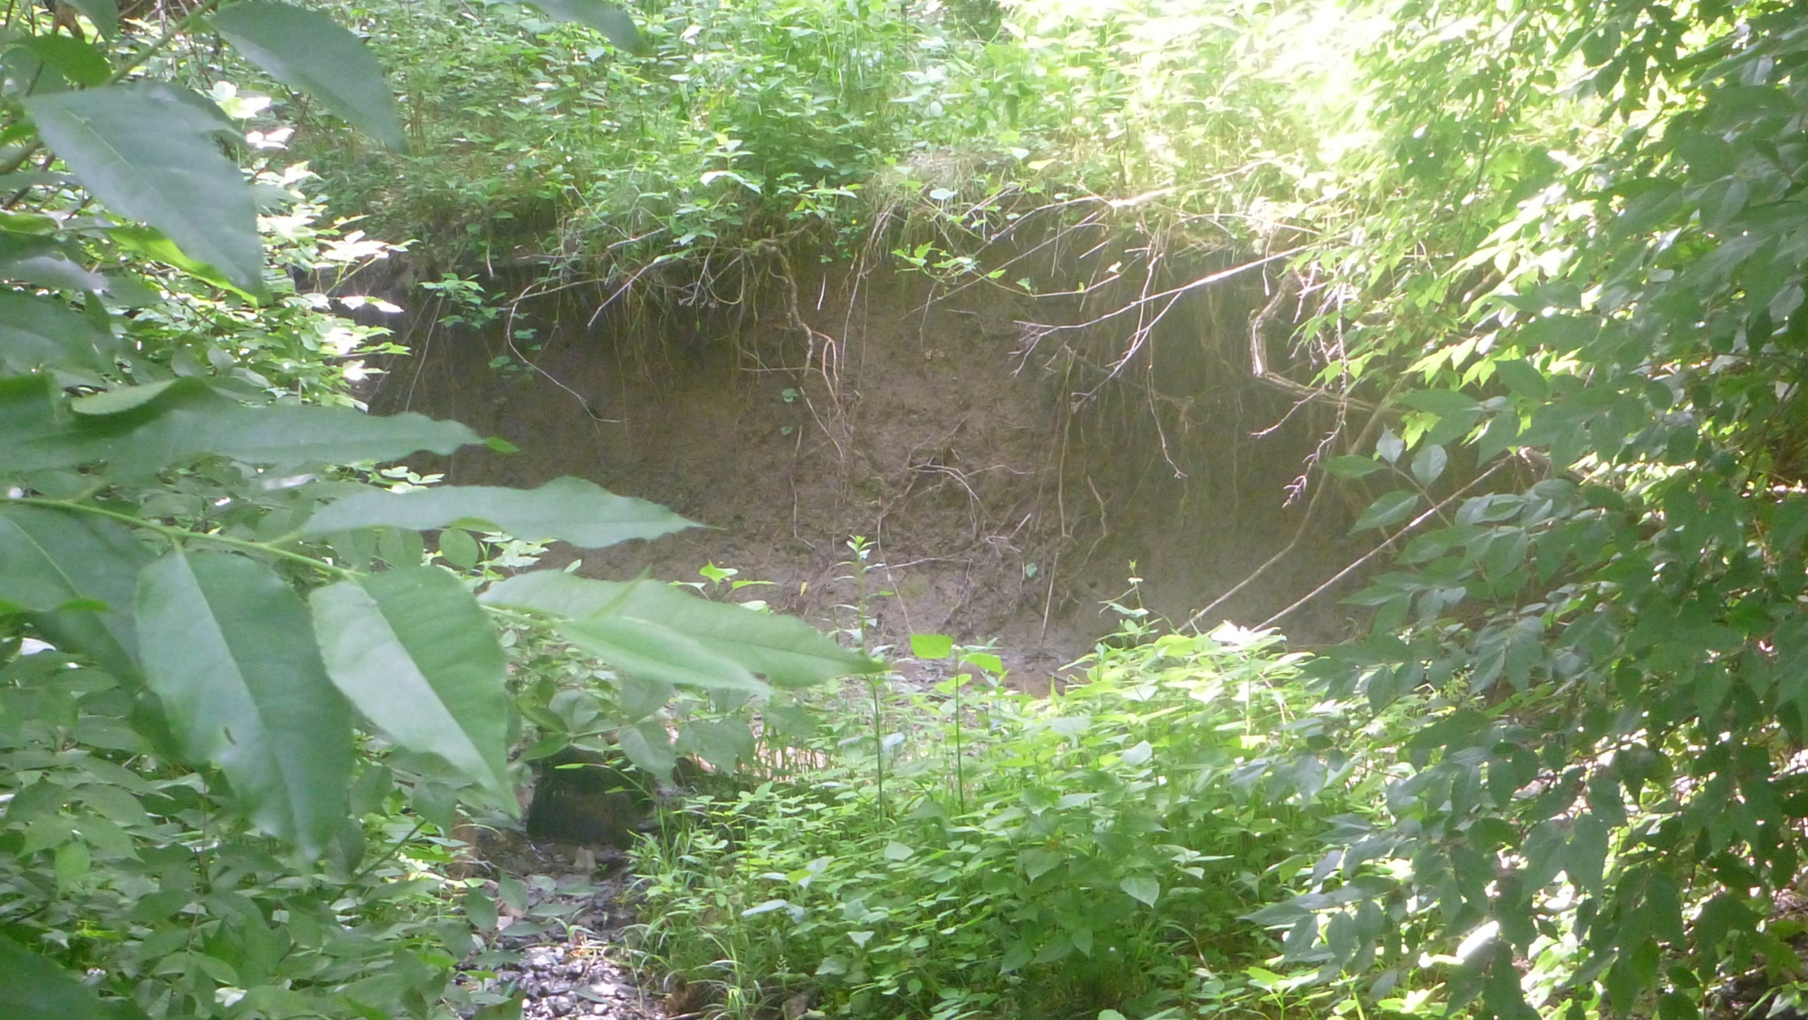
Sediment

Slide 11
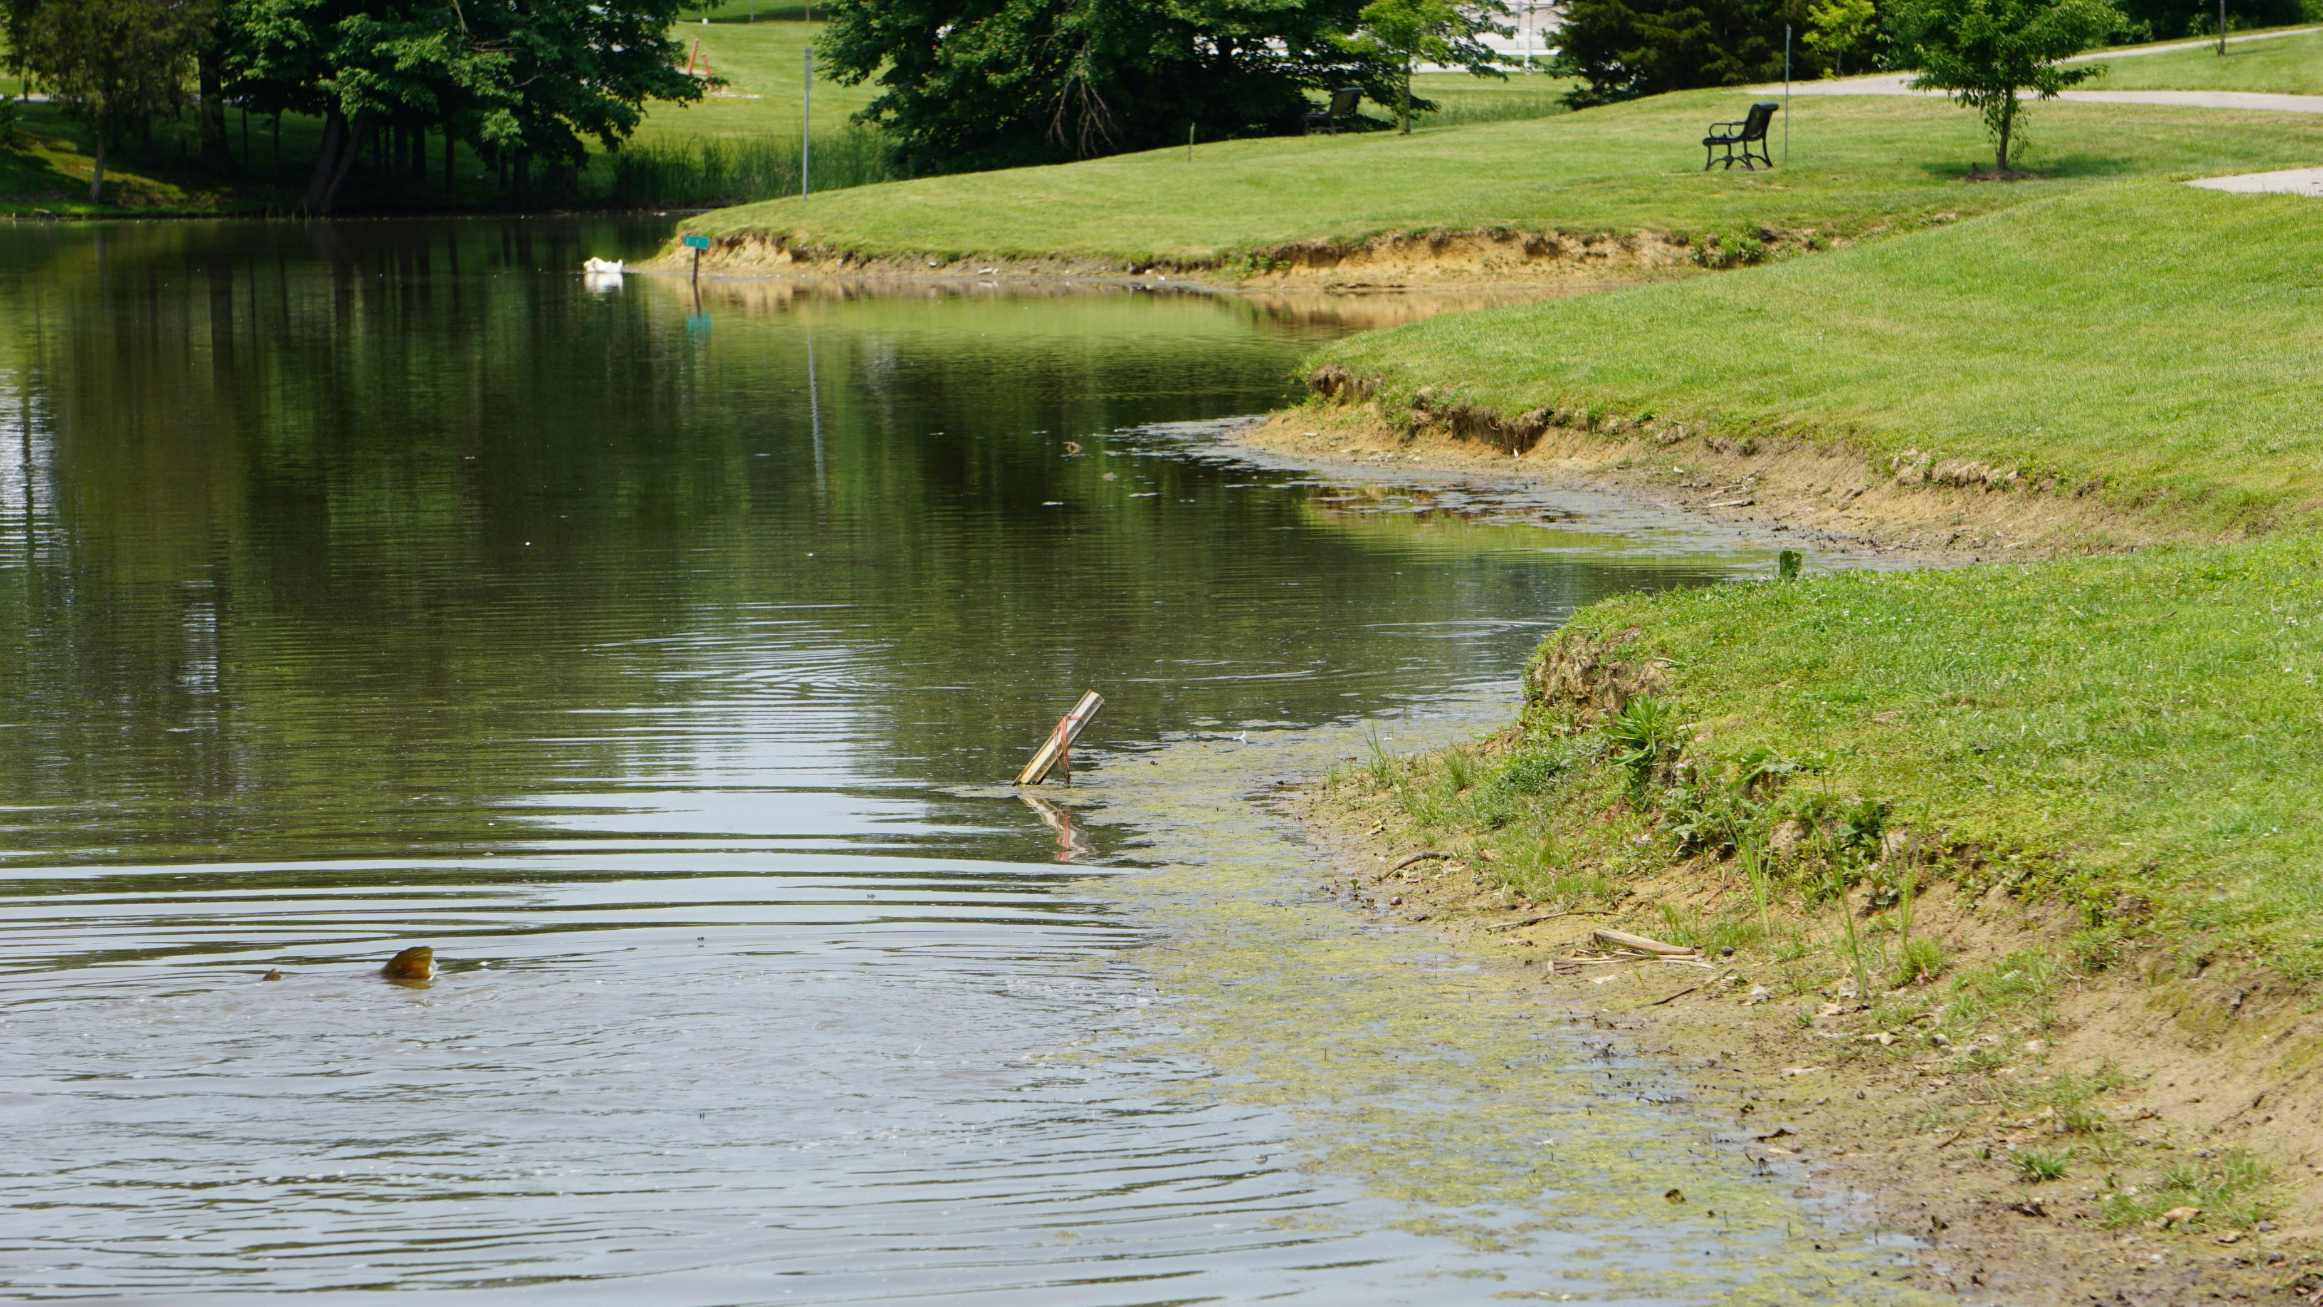
Bank Erosion

Slide 12
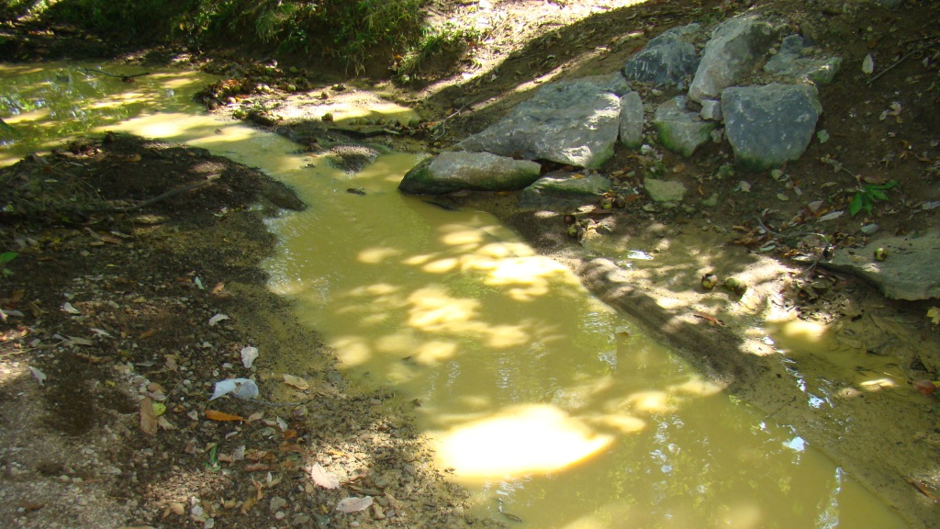
Water Clarity

Slide 13
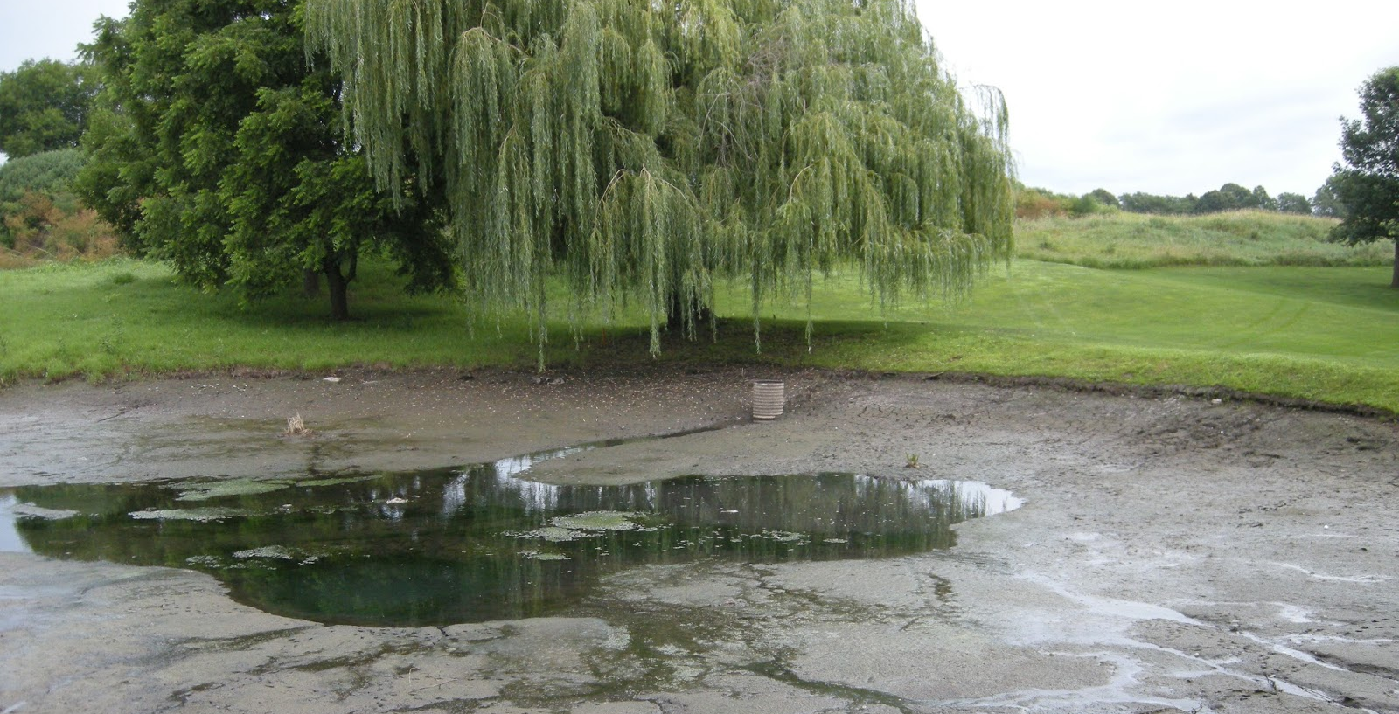

Slide 14
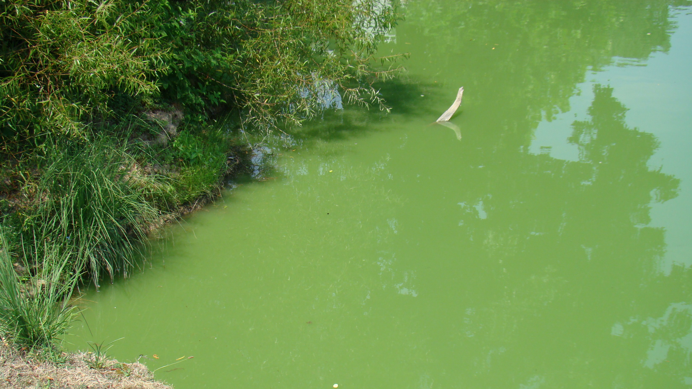
Excess Nutrients

Slide 15
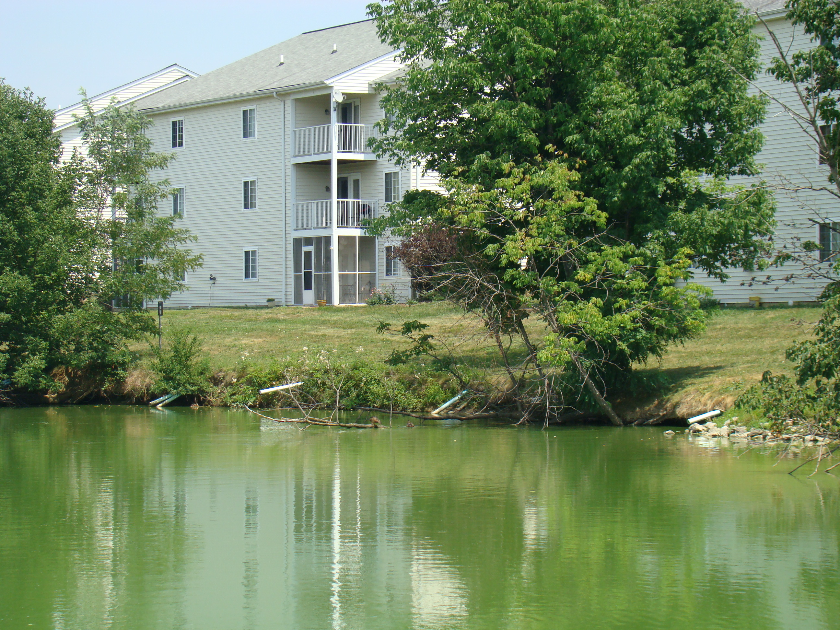

Slide 16
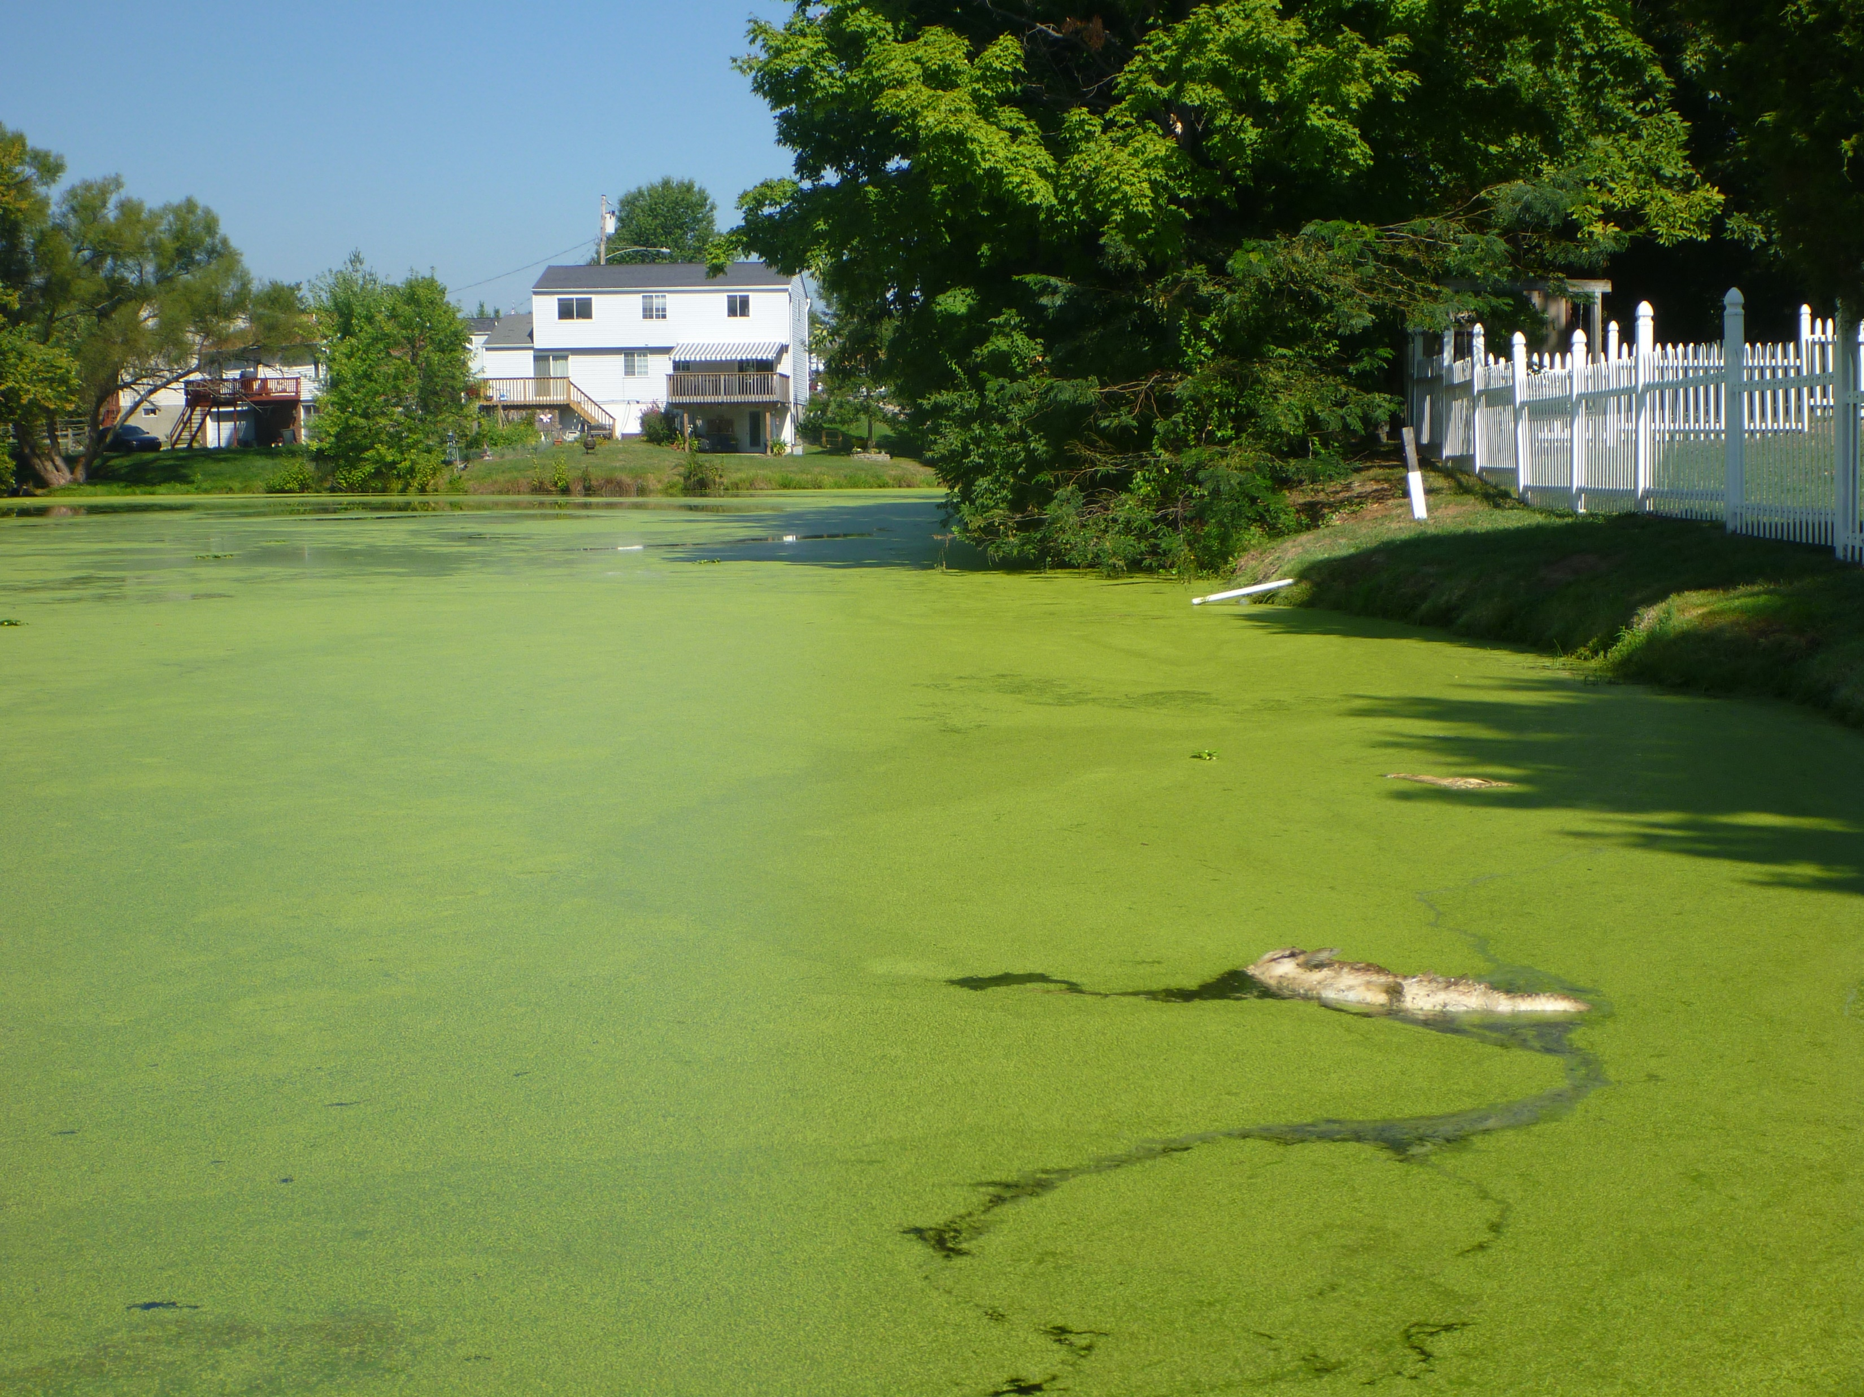

Slide 17
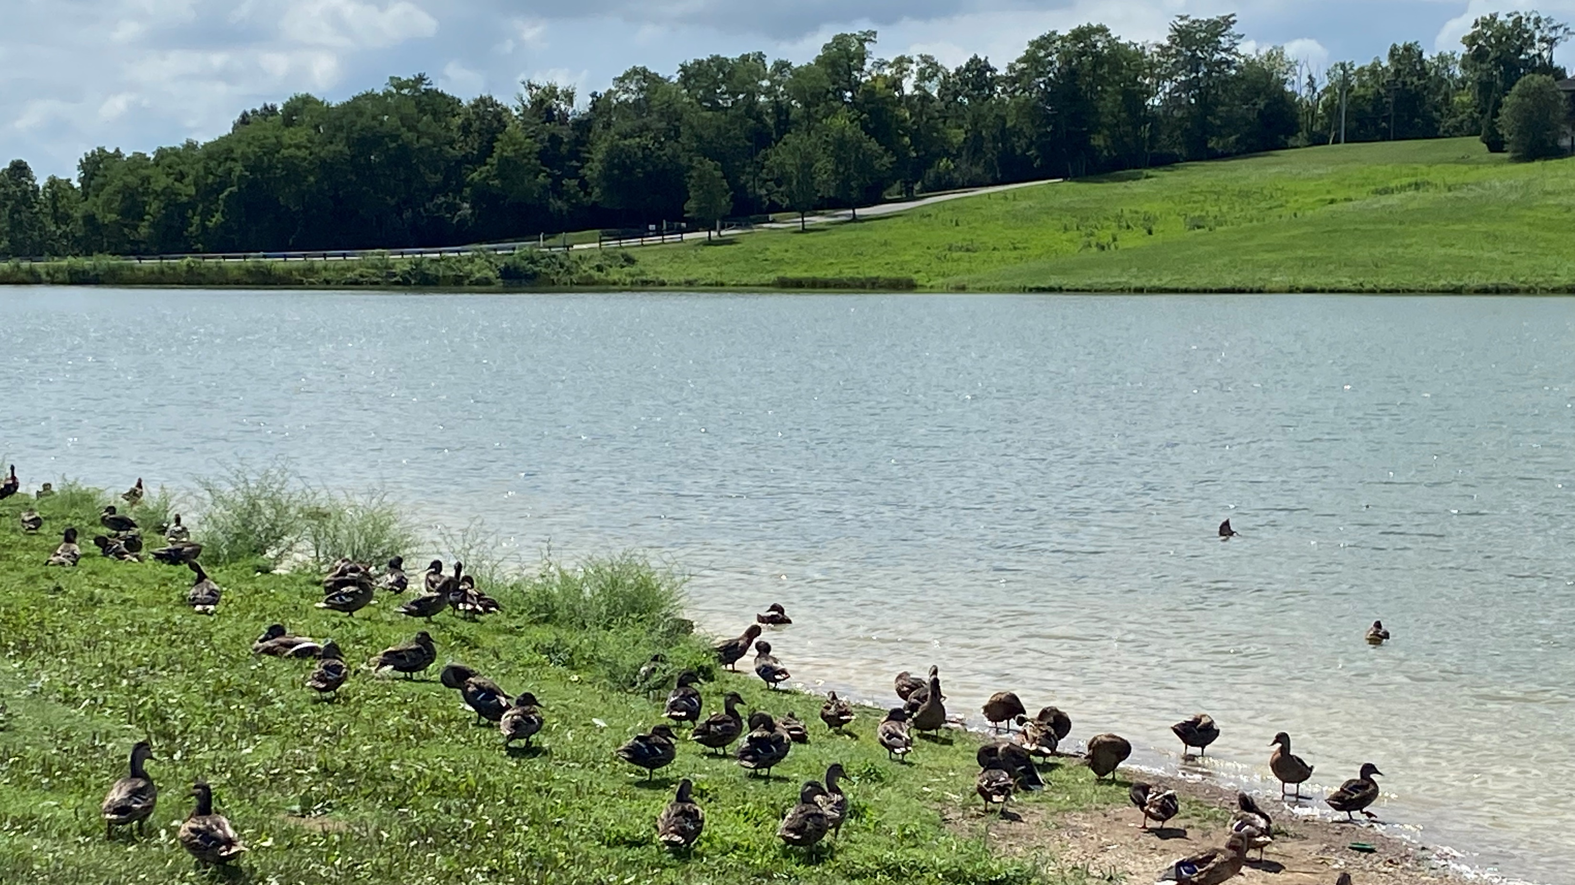
Animal Waste

Slide 18
Aeration

Slide 19
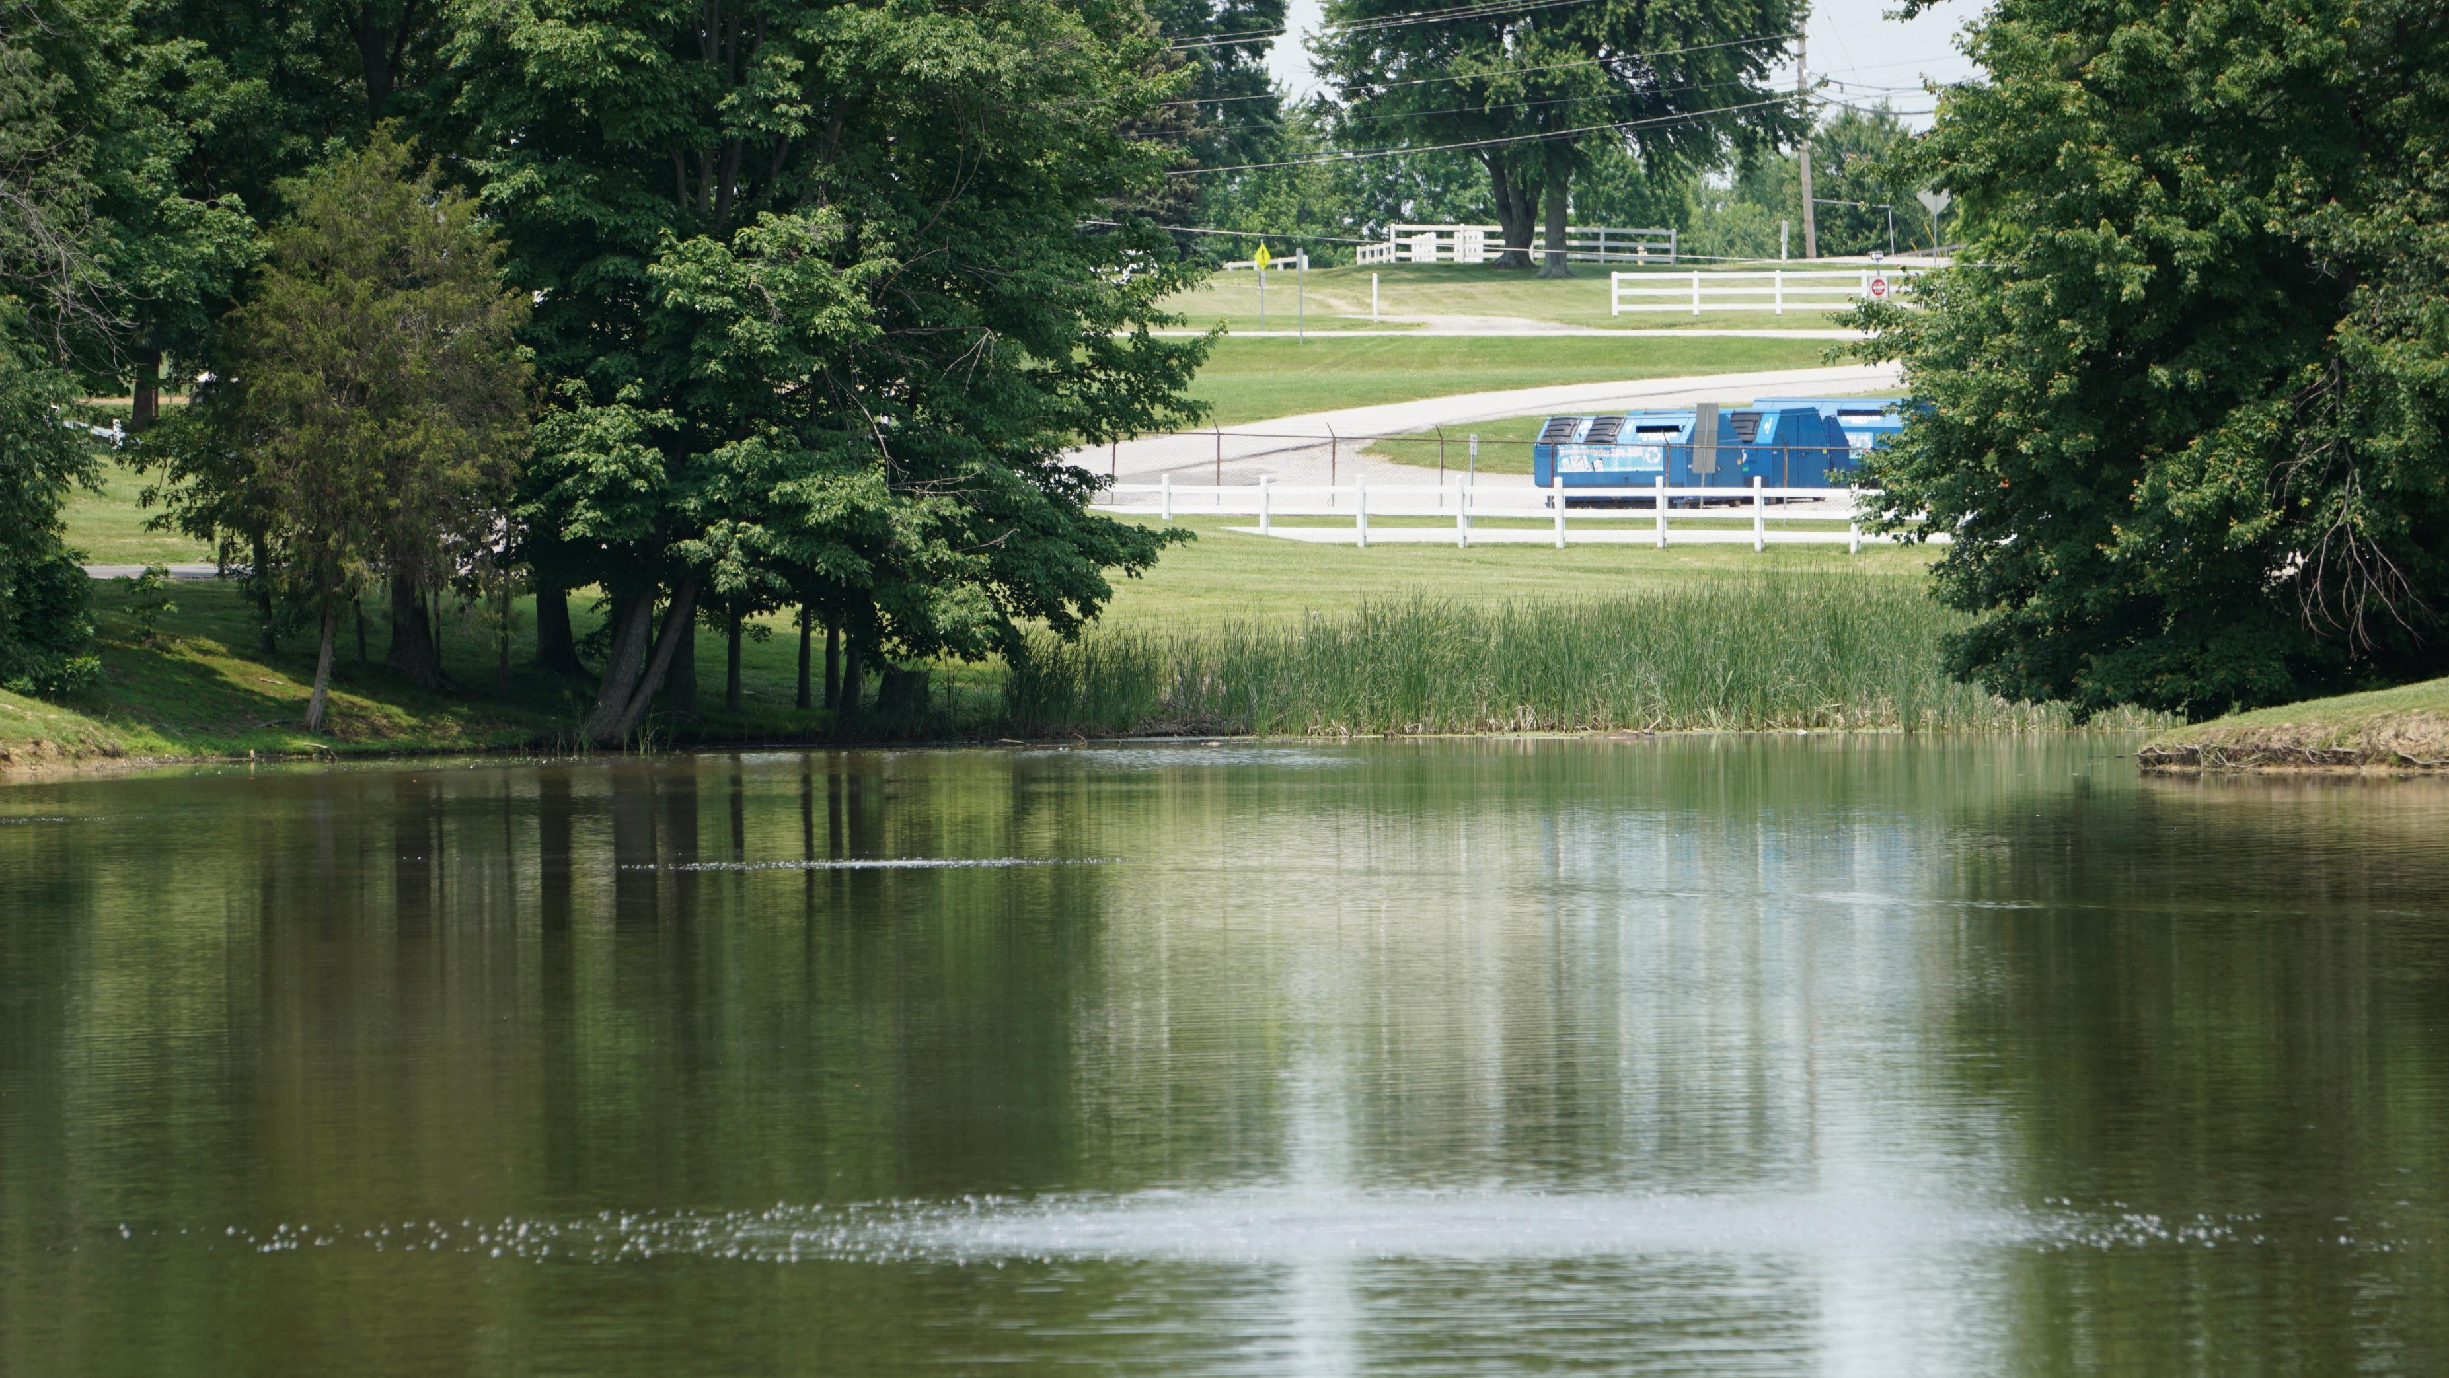

Slide 20
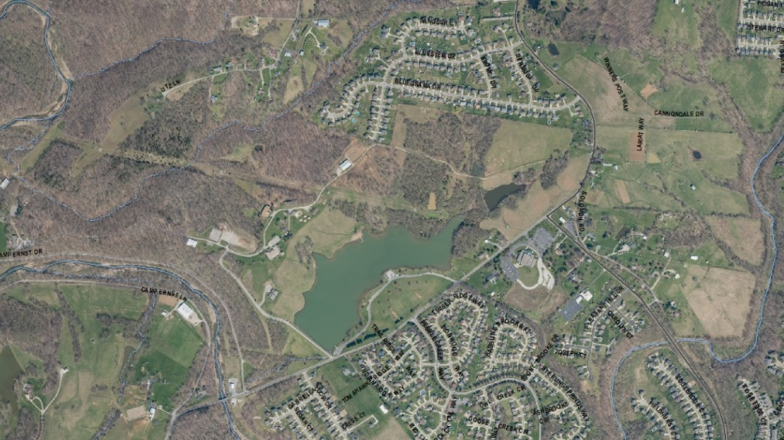
Camp Ernst Lake

Slide 21
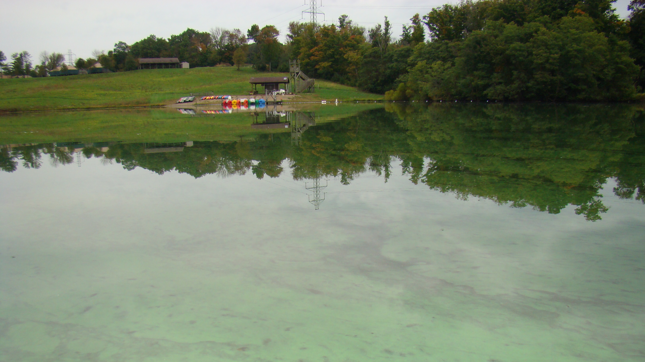

Slide 22
Lake Shore Stabilization
Native vegetation
Coir logs
Cedar revetment

Slide 23
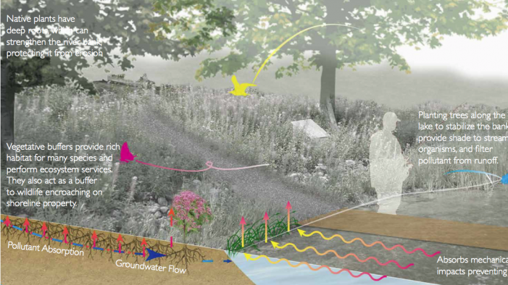

Slide 24
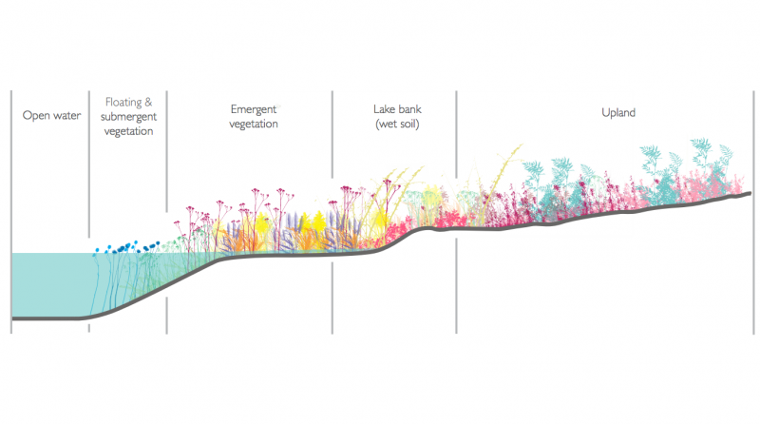

Slide 25
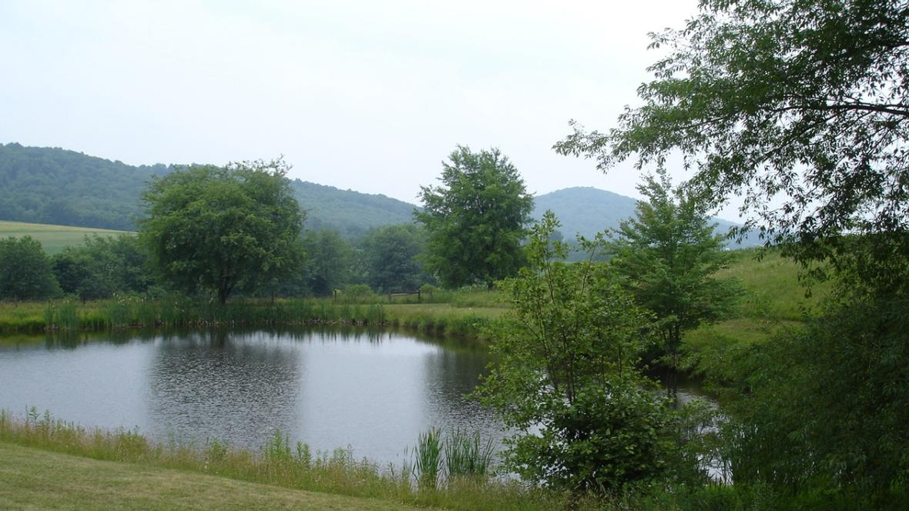

Slide 26
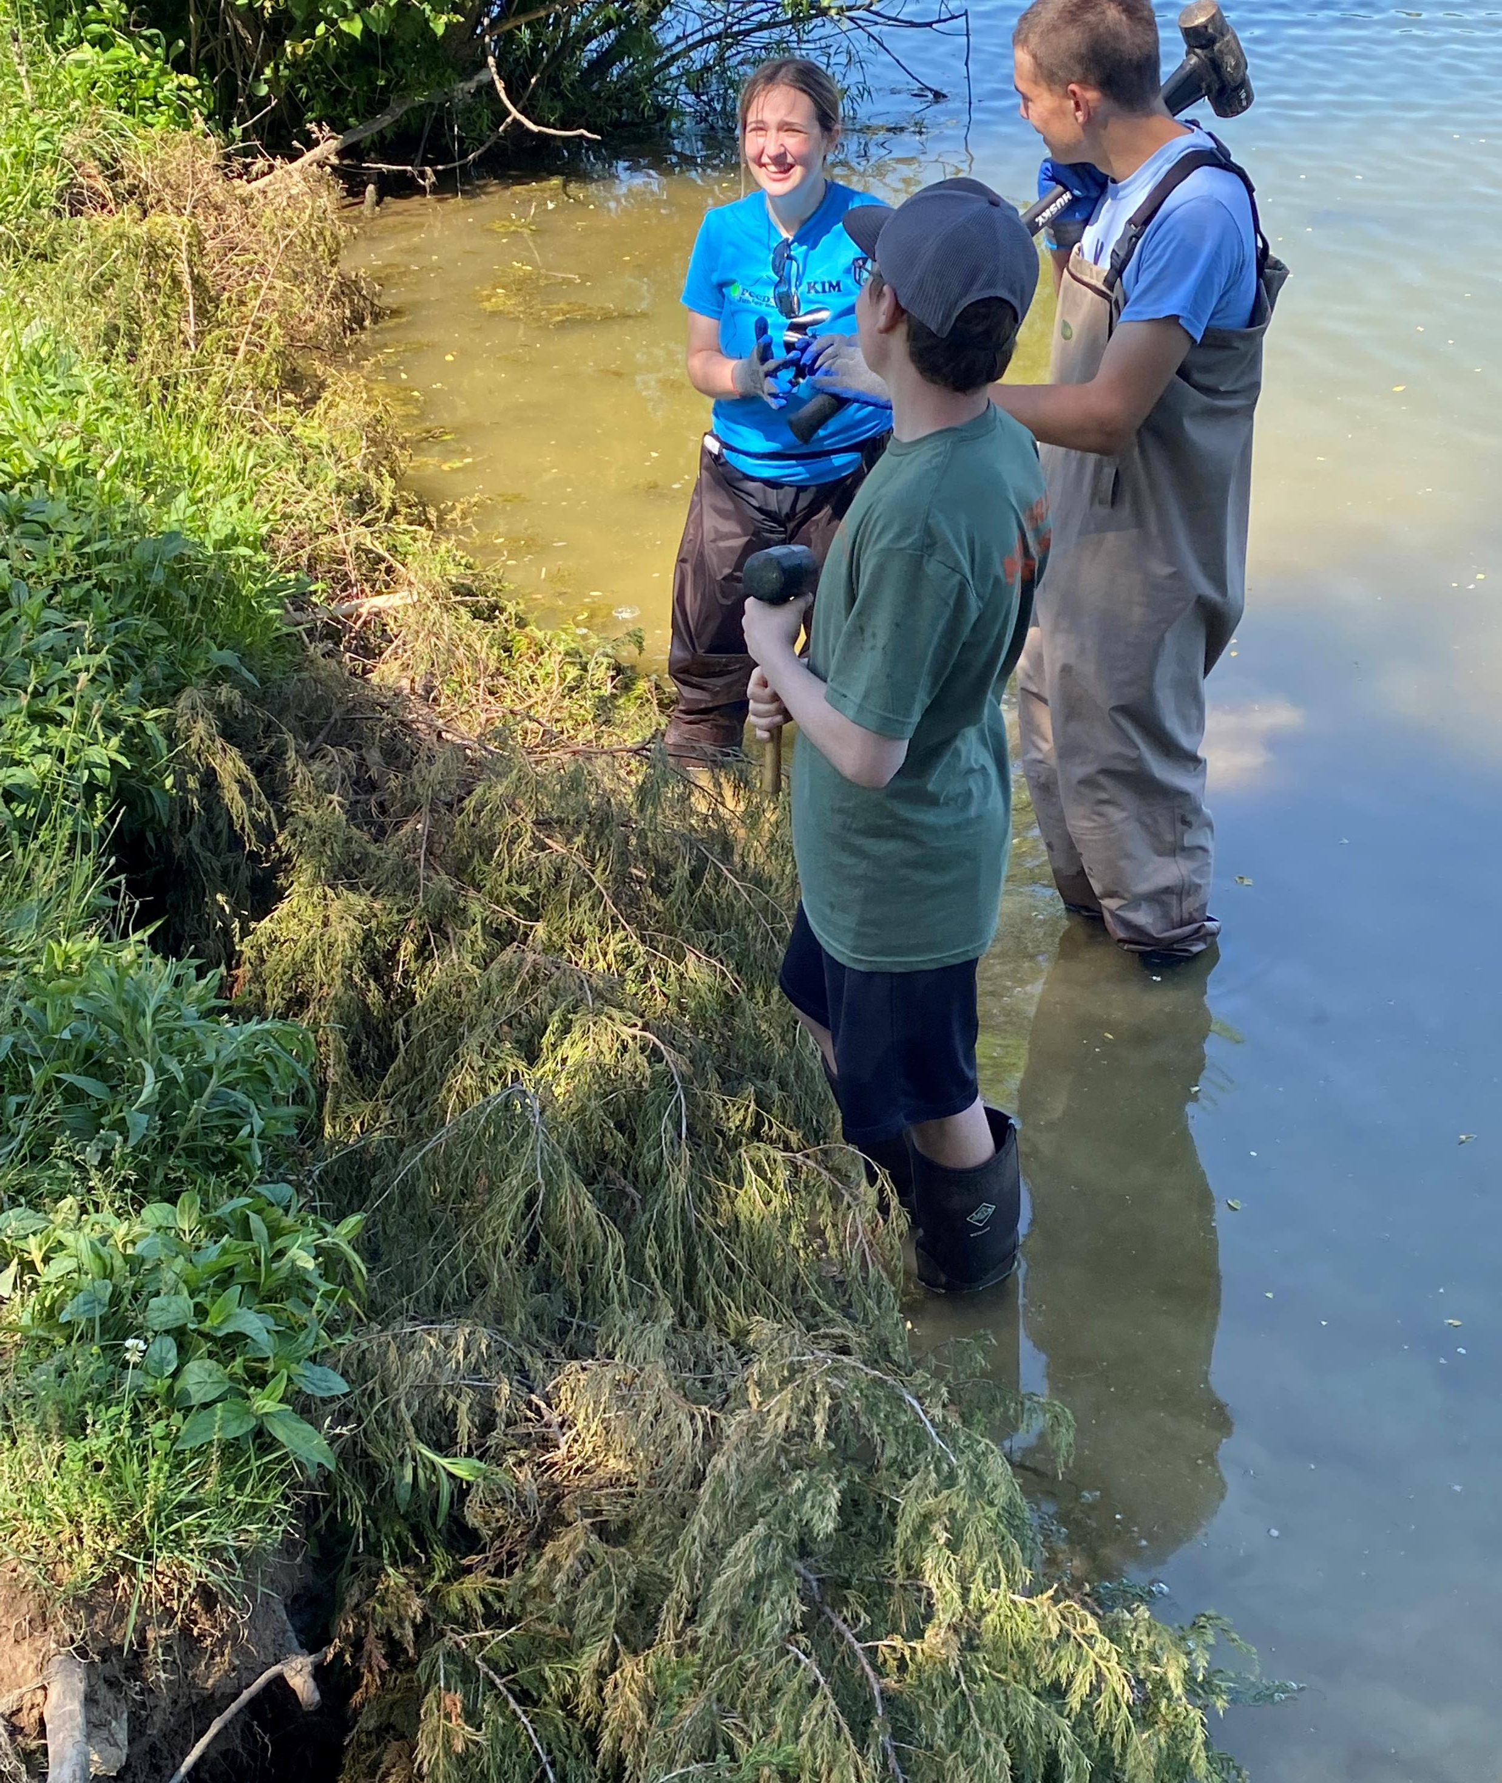
Cedar revetment

Slide 27
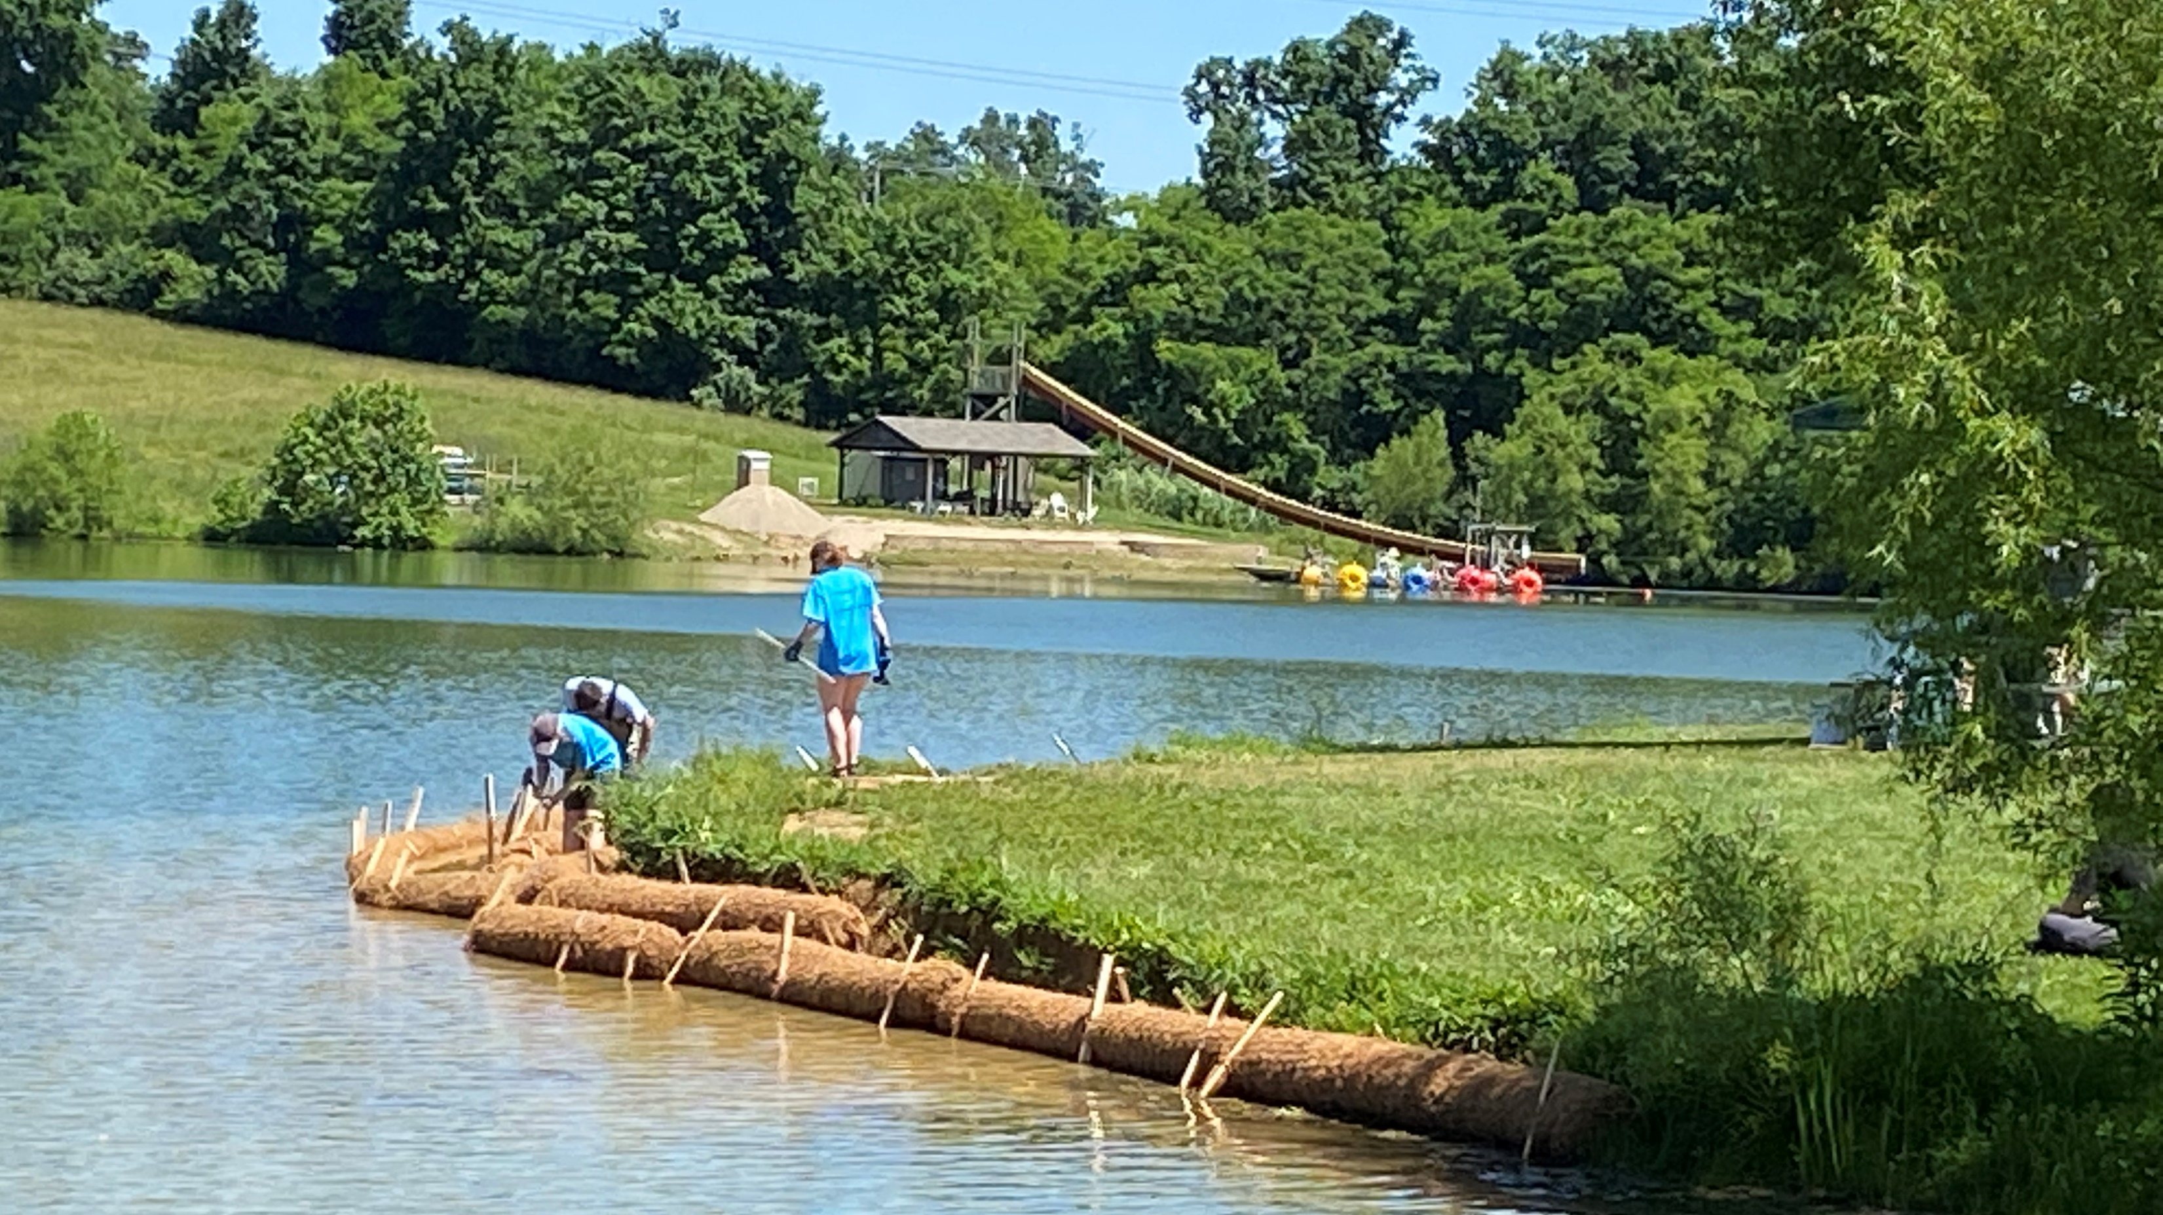
Coir logs

Slide 28
The End
Mark Jacobs
Director of Conservation Programs
Boone County Conservation District
markjacobs@bccdky.org
859-586-7903

